Slide 1
Project On Big Data and Data Science

Slide 2
Introduction

Slide 3
Motivation
On a day to day basis, E-Commerce companies produce vast amounts of transactional data but it is often semi-structured or unstructured which is not too easy to either store or analyze efficiently.
To extract meaningful insights, data cleaning and preprocessing is essential.
This project makes use of Hadoop, and AWS services to store and preprocess the transactional data and Hive for structured querying to prepare data for analysis.
In the analytics phase, we apply Spark MLlib’s K-Means and Gaussian Mixture Model(GMM) clustering to segment customers based on RFM Metrics and use Python visualizations to provide actionable insights.
Importance: Organizations can make smarter choices based on this improved data analysis and do personalized marketing increasing customer loyalty and more efficient operations.

Slide 4
Significance
Clean data reduces bias and prevents misleading insights during analysis.
Efficiently storing the well-structured data in AWS S3 allows for scalability and efficient access for large datasets.
Preprocessing helps in improving Hive query performance as HiveQL is similar to a structured query language and works well with structured data.
Ensures data integrity, accessibility, and efficiency forming a solid foundation for analytical task.
Spark based clustering and python visualizations help in achieving scalable customer segmentation and insights thereby providing fast analysis and clear interpretation of large datasets.
Overall, the project contributes to end-to-end efficient storage, data preprocessing and analysis which are necessary to make data-driven decisions at scale.

Slide 5
Objectives
Data Preprocessing and Storage:
Store, and preprocess an online retail dataset using big data tools such as Hadoop, Hive, and AWS services efficiently.
Clean, transform the raw data into a well-structured format by extracting key RFM (Recency, Frequency, Monetary) metrics for each customer.
Store pre-processed data in Amazon S3 and use Apache Spark for advanced analysis.
Data Analytics and Insights:
Perform customer segmentation using Spark MLlib’s K-Means and Gaussian Mixture Model(GMM) clustering.
Visualize customer segments and purchasing patterns using Matplotlib and Seaborn to provide actionable insights for marketing and customer relationship management.

Slide 6
Features
Data Cleaning: Deleting duplicate records, handling missing values and removing or adjusting erroneous records (e.g., negative or zero quantities and unit prices).
Data Transformation: Standardizing date formats, and applying normalization or encoding categorical features wherever necessary.
Storage: Used AWS S3 buckets & EMR clusters to manage large-scale data processing.
Querying: HiveQL queries are executed to perform Data Cleaning, and Transformation.
Data Analysis: Used PySpark to perform EDA and RFM metric extraction.
ML-Based Analytics: Applied K-Means and GMM Clustering using Spark MLlib for customer segmentation.
Visualization: Used Python libraries (Matplotlib, Seaborn).

Slide 7
Model

Slide 8
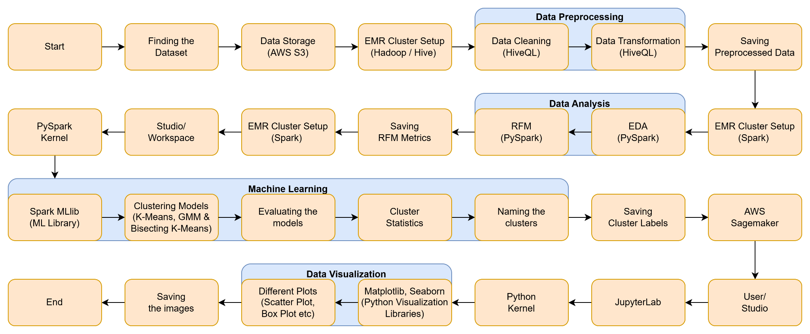
Workflow Diagram

Slide 9
Explanation of Workflow Diagram
Finding the Dataset: Explored Kaggle datasets to get the dataset for this project.
Data Storage: AWS S3 Bucket used for storing the raw dataset.
Cluster Setup: AWS EMR Cluster configured to run Hadoop/Hive is launched.
Data Cleaning & Transformation: HiveQL used for cleaning and transforming the dataset.
Saving Preprocessed Data: Preprocessed Data is saved to output folder in the S3 Bucket.
Cluster Setup: AWS EMR Cluster configured to run Spark is launched.
EDA & RFM: Using Pyspark’s dataframes performed detailed data analytics and computed R, F and M metrics.
Saving RFM Metrics: Computed RFM values are saved in a csv file in a S3 Bucket.
Spark MLlib: Apache Spark’s Machine Learning library.

Slide 10
Explanation of Workflow Diagram
Clustering Models: Implemented K-Means, Bisecting K-Means and GMM with 4 clusters.
Model(s) Evaluation: Evaluated the models using metrics such as Silhouette score.
Cluster Statistics: Computed min, max and average of each clusters along with the centroids and mean, co-variance matrices.
Cluster Naming: Named the clusters such as Churned ,VIP, New customers etc.
Saving Cluster Labels: Saved the cluster labels in a csv file in a S3 Bucket.
AWS SageMaker: AWS Cloud-based platform for Machine Learning used for visualization in this project.
JupyterLab: Used to open the python kernel and execute the python code.
Data Visualization: Used Python’s libraries Matplotlib and Seaborn for visualization.
Saving the Images: The images are saved back into a S3 bucket.

Slide 11
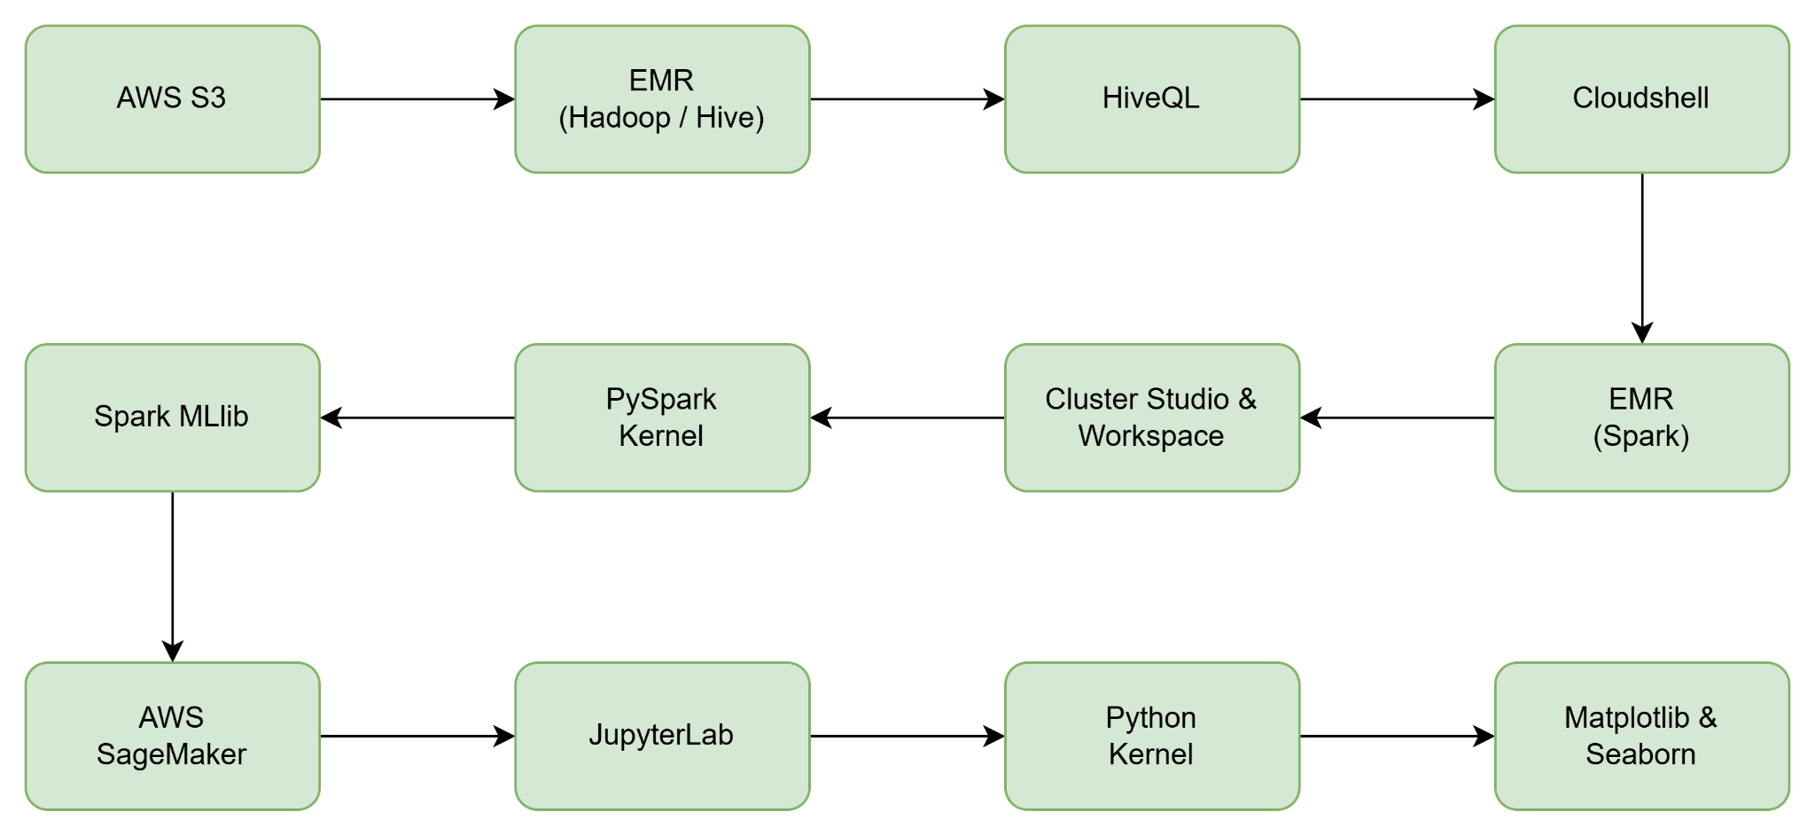
Architecture Diagram

Slide 12
Explanation of Architecture Diagram
An AWS S3 bucket is created where we upload our raw dataset and EMR Cluster configured with Hadoop is initialized. Then we connect local machine with the AWS Cluster by using the public DNS and initiate Hive to use HiveQL queries to clean and transform the data. Once that is done we save the preprocessed data in the output folder of the S3 bucket which was merged into a single CSV file using Cloudshell commands.
An AWS EMR Cluster configured with PySpark is initialized. Using PySpark’s Dataframes we did detailed data analytics and computed Recency, Frequency and Monetary values which are vital for projects related to customer segmentation based on purchase history. These values are saved in a new csv file which is then uploaded back to S3 bucket.

Slide 13
Explanation of Architecture Diagram
An AWS EMR Cluster configured with PySpark is initialized. Using Apache Spark’s Machine Learning library MLlib we implemented three various clustering models: K-Means, Bisecting K-Means and Gaussian Mixture Model (GMM) with 4 clusters. We evaluated them using Silhouette score and few other metrics. We computed few statistics measures of the clusters such as min, max, average, centroid, mean and co-variance matrices. We assigned names to the clusters based on percentiles value of the whole data. The cluster labels were saved in a csv file and stored back in S3 bucket.
We created a JupyterLab space using AWS SageMaker and open a python kernel in JupyterLab. Used Python’s visualization libraries namely Matplotlib and Seaborn for all the visualizations in the project. The images were saved back to the S3 bucket.

Slide 14
Dataset

Slide 15
Overview
The Online Retail Dataset is a structured collection of transactional data from a UK-based online retail, capturing all transactions over an eight-month period.
This dataset is well-suited for preprocessing task, as it provides detailed records of sales transactions through both numerical and categorical attributes, enabling thorough data cleaning and transformation.
The dataset is a structured in a CSV format, making it easily accessible for processing using HiveQL and big data tools.
There are 8 attributes in the dataset out of which we involved 7 columns in Data Preprocessing.

Slide 16
Feature Design & Diagram
These are the Attributes which were used for Preprocessing And Analysis
InvoiceNo: deleted rows with NULL values, checked for duplicates.
StockCode: deleted rows with NULL values.
Description: checked for NULL, empty, “unknown” descriptions, Replaced incorrect or empty descriptions.
Quantity: validation for negative, removed invalid rows, Normalization and scaling.
InvoiceDate: deleted rows with NULL values, reformatted the-date yyyy-mm-dd HH:mm.
UnitPrice: validation for negative, removed invalid rows, Normalization and scaling.
CustomerID: deleted rows with NULL values.
Country: No changes made.
Checked and removed all the duplicate entries for all columns and final verification for missing values is also performed.

Slide 17
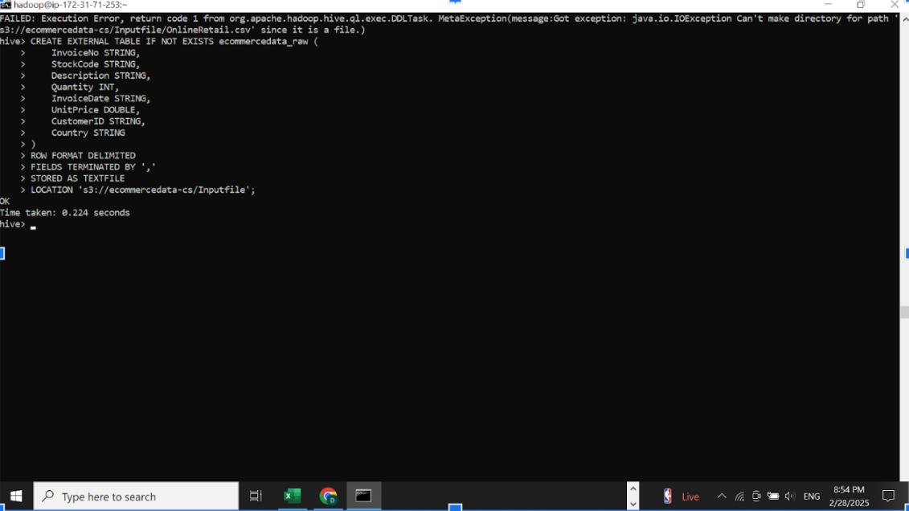
Data Types

Slide 18
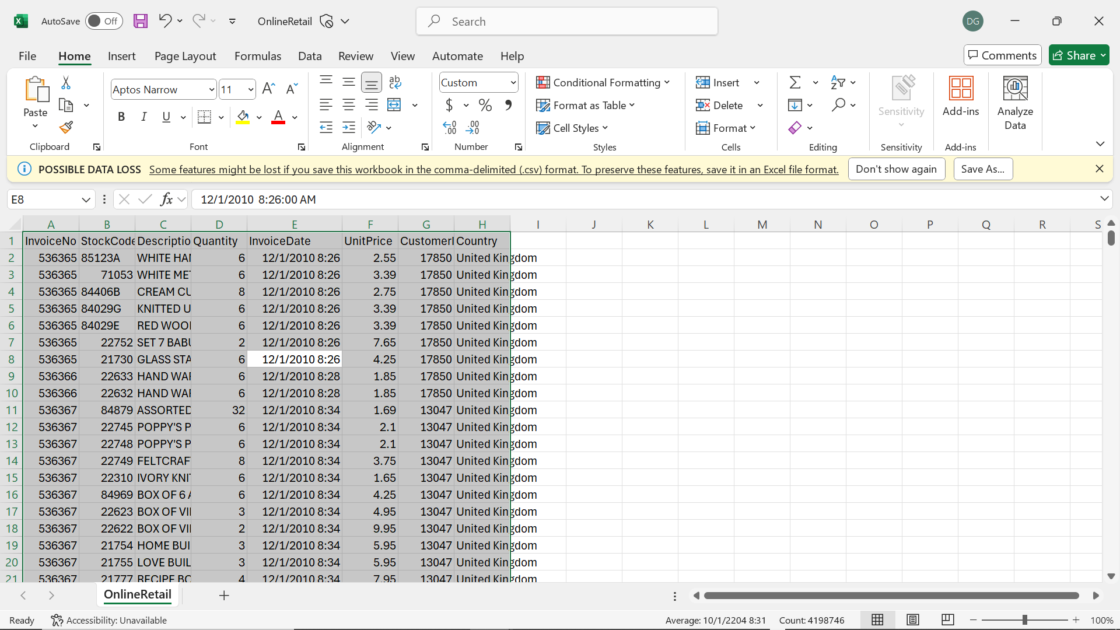
Image of the Raw Dataset

Slide 19
Analysis of Data

Slide 20
Data Preprocessing Steps
Data Storage: original dataset is uploaded to AWS S3 bucket for secure and scalable storage.
Launching the Cluster: EMR Cluster configured to run Hadoop is set up and started.
Data Cleaning: HiveQL queries are performed to clean the data by dealin with duplicates, missing values and zero/negative values.
Data Transformation: Hive QL queries are executed to transform the data by standardizing InvoiceDate and performing normalizing and encoding as necessary.
Saving Processed Data: Cleaned and transformed data is merged and saved in the output folder of the S3 bucket.
The preprocessed data which was stored back to S3 was downloaded and was sent for analysis.

Slide 21
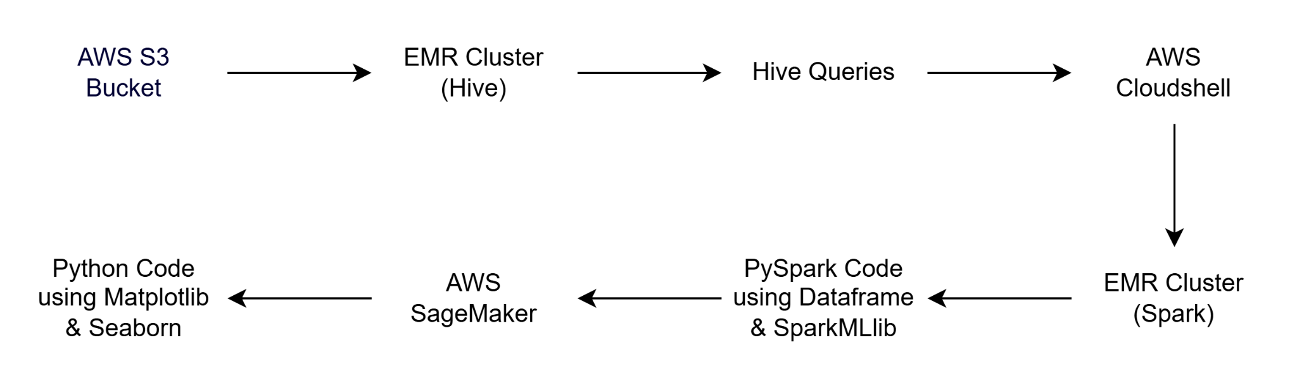
Graph Model for Tools

Slide 22
Query Implementation For Preprocessing
Queries like : Creating table for raw data, Columns containing missing values, Delete rows with null values, Replace null Description as unknown, Reformat the date, Removing negative quantities and prices such kind of queries were performed.
Columns containing missing values CREATE TABLE ecommercedata_missing_check AS SELECT COUNT(*) AS total_rows,SUM(CASE WHEN InvoiceNo IS NULL THEN 1 ELSE 0 END) AS missing_InvoiceNo,SUM(CASE WHEN StockCode IS NULL THEN 1 ELSE 0 END) AS missing_StockCode,SUM(CASE WHEN Description IS NULL THEN 1 ELSE 0 END) AS missing_Description,SUM(CASE WHEN Quantity IS NULL THEN 1 ELSE 0 END) AS missing_Quantity,SUM(CASE WHEN InvoiceDate IS NULL THEN 1 ELSE 0 END) AS missing_InvoiceDate,SUM(CASE WHEN UnitPrice IS NULL THEN 1 ELSE 0 END) AS missing_UnitPrice,SUM(CASE WHEN CustomerID IS NULL THEN 1 ELSE 0 END) AS missing_CustomerID, SUM(CASE WHEN Country IS NULL THEN 1 ELSE 0 END) AS missing_CountryFROM ecommercedata_raw;

Slide 23
Delete rows with Null Values CREATE TABLE ecommercedata_cleaned AS SELECT* FROM ecommercedata_raw WHERE InvoiceNo IS NOT NULL AND StockCode IS NOT NULL AND InvoiceDate IS NOT NULL AND CustomerID IS NOT NULL;
Reformat the date CREATE TABLE ecommercedata_fixed_data AS SELECT InvoiceNo, StockCode, Description, Quantity, FROM_UNIXTIME(UNIX_TIMESTAMP(InvoiceDate, ‘MM/DD/YYYY HH:mm’)) AS InvoiceDate, UnitPrice, CustomerID, Country FROM ecommercedata_final_description;
Remove negative quantities and prices CREATE TABLE ecommercedata_final_cleaned AS SELECT*FROM ecommercedata_fixed_date WHERE Quantity >=0 AND UnitPrice >=0;

Slide 24
Query Implementation for Analysis
Most Popular Products (by Quantity)
Identifies the top-selling products across the dataset.
Guides inventory planning, bundling, and featured promotions.
popular_products_df = df.groupBy("Description") \
.agg(sum("Quantity").alias("TotalSold")) \
.orderBy(col("TotalSold").desc())
popular_products_df.show(5)

Slide 25
Query Implementation for Analysis
Recency Calculation
Calculates how many days have passed since each customer’s last purchase.
Helps identify recent vs inactive customers for targeted campaigns or re-engagement.
from pyspark.sql.functions import max, datediff, lit, to_date
df = df.withColumn("InvoiceTimestamp", to_date("InvoiceTimestamp"))
max_date = df.agg(max("InvoiceTimestamp")).collect()[0][0]
recency_df = df.groupBy("CustomerID") \
.agg(max("InvoiceTimestamp").alias("LastPurchaseDate")) \
.withColumn("Recency", datediff(lit(max_date), "LastPurchaseDate"))
recency_df.show()

Slide 26
Query Implementation for Analysis
Frequency Calculation
Measures how frequently each customer makes purchases.
Useful in identifying loyal customers and monitoring purchase behavior.
from pyspark.sql.functions import countDistinct
frequency_df = df.select("CustomerID", "InvoiceNo").dropDuplicates() \
.groupBy("CustomerID") \
.agg(countDistinct("InvoiceNo").alias("Frequency"))
frequency_df.show()

Slide 27
Query Implementation for Analysis
Monetary Calculation
Calculates the total spending of each customer.
Helps in distinguishing high-value customers and potential VIPs.
from pyspark.sql.functions import sum, round, col
df = df.withColumn("Revenue", col("Quantity") * col("UnitPrice"))
monetary_df = df.groupBy("CustomerID") \
.agg(round(sum("Revenue"), 2).alias("Monetary"))
monetary_df.show()

Slide 28
Implementation

Slide 29
Integration Of Frameworks and Tools
Cloud & Infrastructure:
AWS S3: Raw data storage.
AWS EMR: Cluster platform used twice—first with Hadoop/Hive, later with Spark.
Data Preprocessing Layer:
HiveQL: Used for both cleaning and transforming the dataset within the Hadoop ecosystem.
Data Analysis Layer:
PySpark: RFM computation and EDA performed using PySpark on Spark-based EMR.
Machine Learning Layer:
Spark MLlib: Applied clustering models like K-Means, GMM, and Bisecting K-Means.
Deployment & Visualization:
AWS SageMaker: Possibly used for saving or deploying cluster labels.
JupyterLab + Python Kernel: Used with Matplotlib and Seaborn to visualize the final results.
Flow: Dataset → HiveQL (Preprocessing) → PySpark (Analysis & ML) → Spark MLlib
(Clustering) → AWS SageMaker / Jupyter (Visualization & Output)

Slide 30
Implementation of Each Component
Component | Role in the Project
AWS S3 | Centralized storage for raw and preprocessed data.
EMR + Hadoop/Hive | HiveQL used to clean and transform data in a distributed fashion.
EMR + Spark | Spark cluster set up to perform RFM scoring, EDA, and model training using PySpark.
PySpark | Used to compute RFM metrics, perform exploratory data analysis, and handle big data workflows.
Spark MLlib | Provided scalable ML algorithms: K-Means, GMM, Bisecting K-Means.
AWS SageMaker | Optional platform to save or serve cluster labels for downstream applications.
JupyterLab | IDE used for analysis, visualization, and reporting.
Python Libraries | Matplotlib, Seaborn used for plotting scatter, box plots, and interpreting cluster characteristics.

Slide 31
Pros & Cons of Integration
Pros
Seamless Big Data Processing: Hive and Spark on EMR allow fast, scalable transformations and computations.
Modular Design: Clear separation between preprocessing, analysis, modeling, and visualization.
Scalable ML: Spark MLlib scales clustering over massive datasets.
Cloud-Native: AWS services (S3, EMR, SageMaker) offer flexibility and scalability.
Interactive Visualizations: Python tools provide intuitive insight delivery.
Cons
Multi-Tool Complexity: Requires deep understanding of Spark, HiveQL, Python, and cloud services.
Data Movement Overhead: Transferring data between Hive, Spark, and S3 may introduce latency.
Cost Management: Running multiple EMR clusters and SageMaker adds to cloud resource costs.
Debugging Difficulty: Distributed computing makes tracing errors more complex.

Slide 32
Results

Slide 33
Data Preprocessing

Slide 34
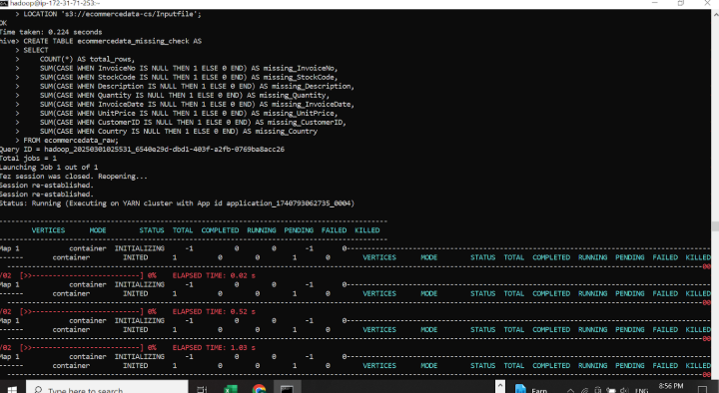
As shown in the below screenshot SUM is used to find the sum of total missing values in each column.

Slide 35
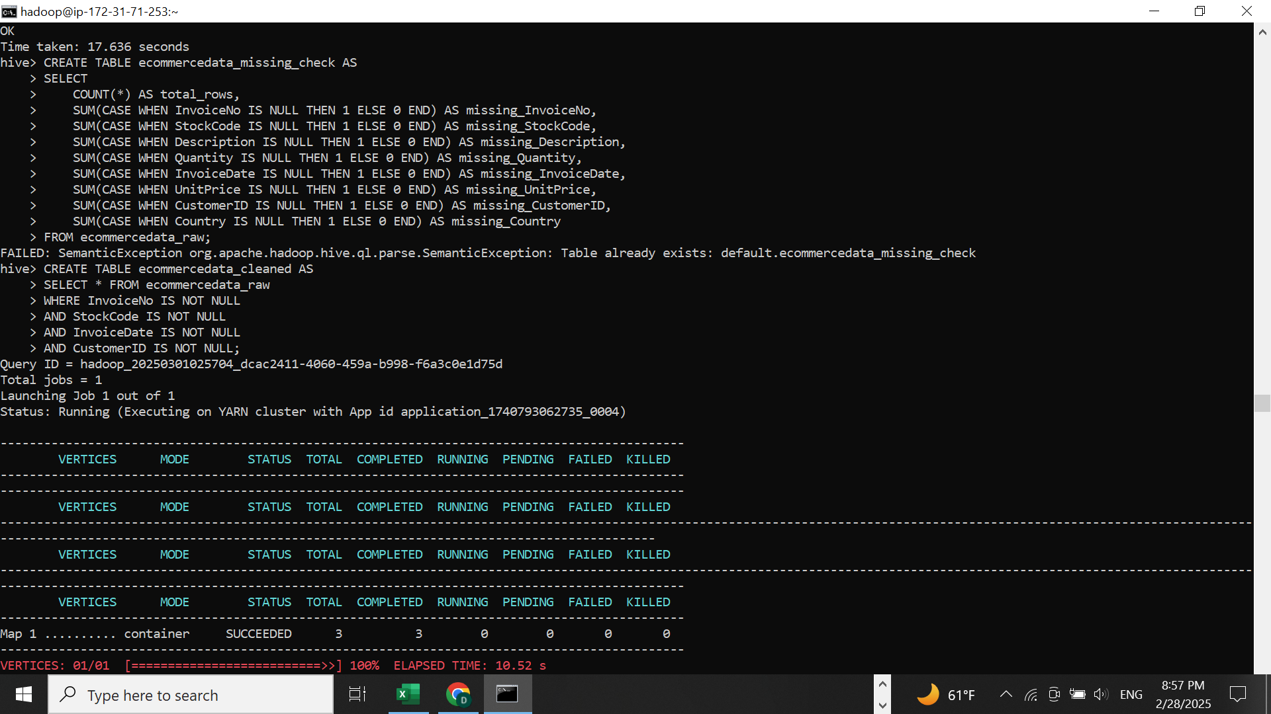
Remove Null Values

Slide 36
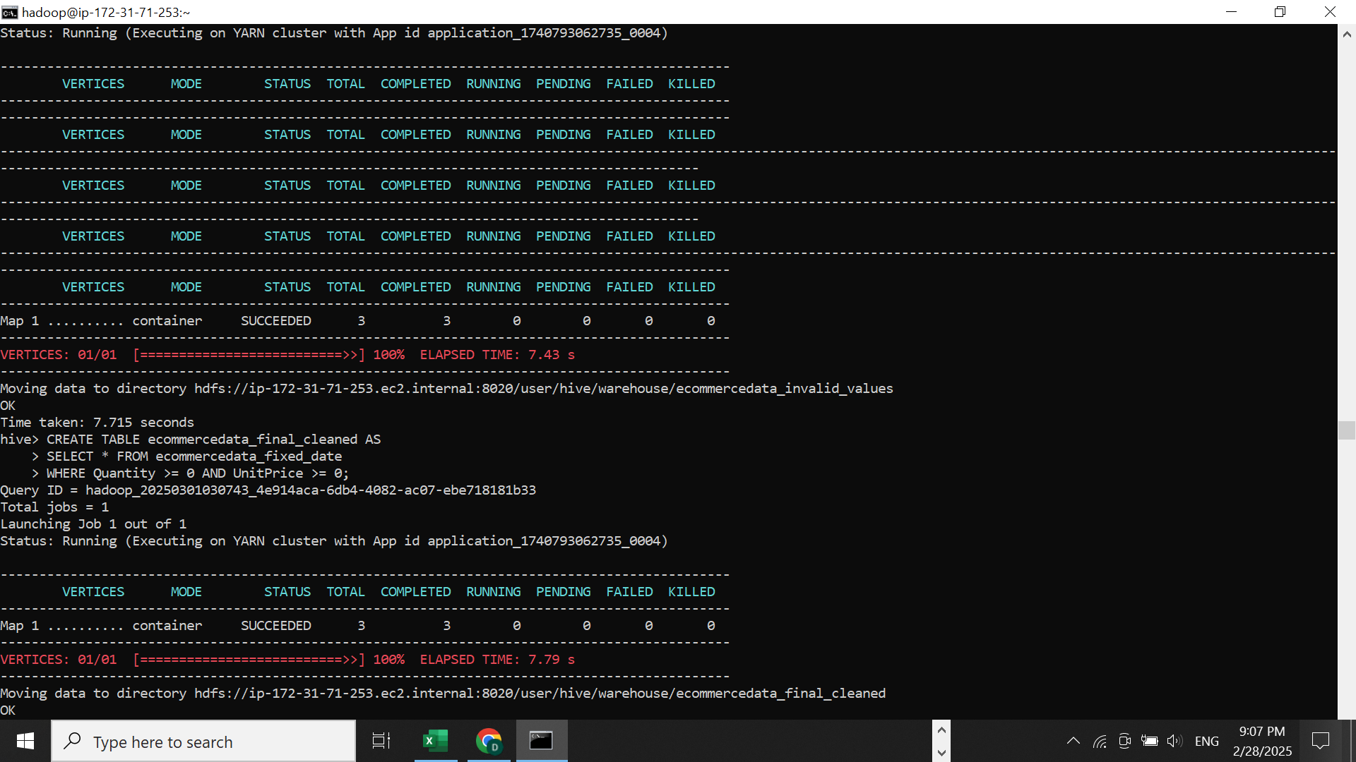
Clear negative values

Slide 37
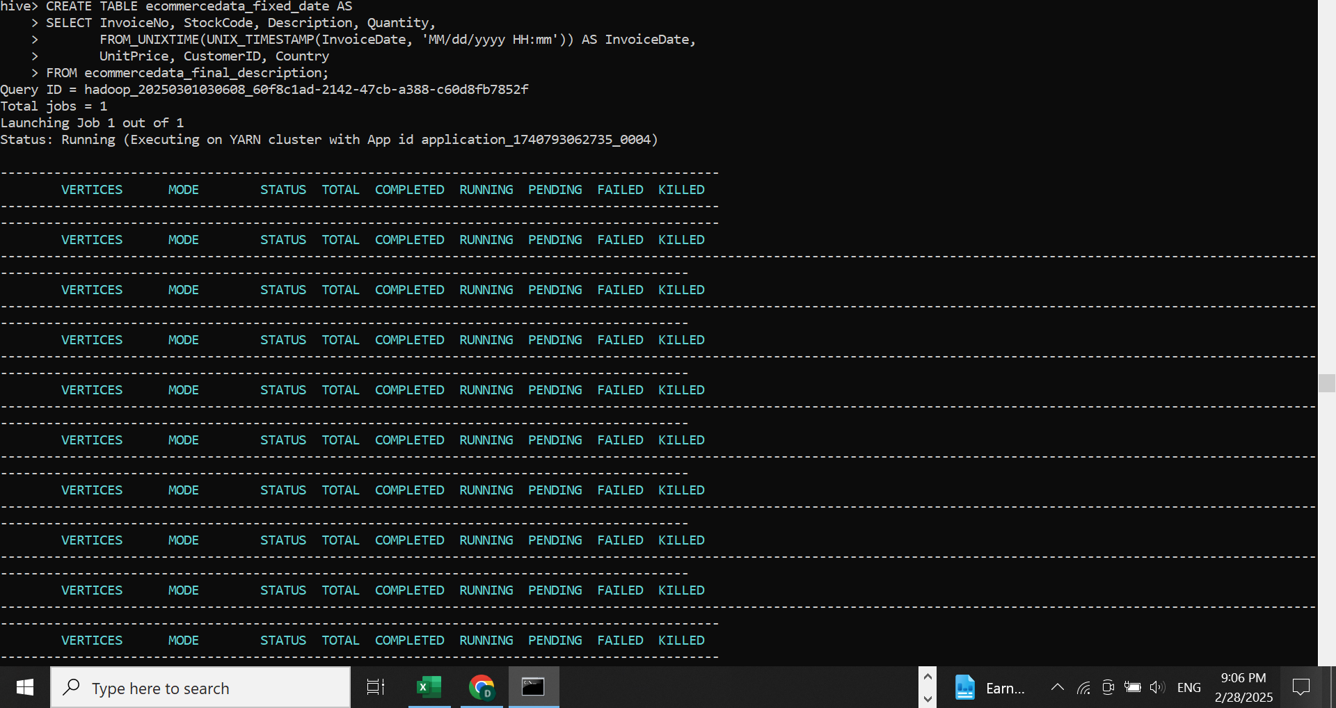
Standardizing InvoiceDate Format

Slide 38
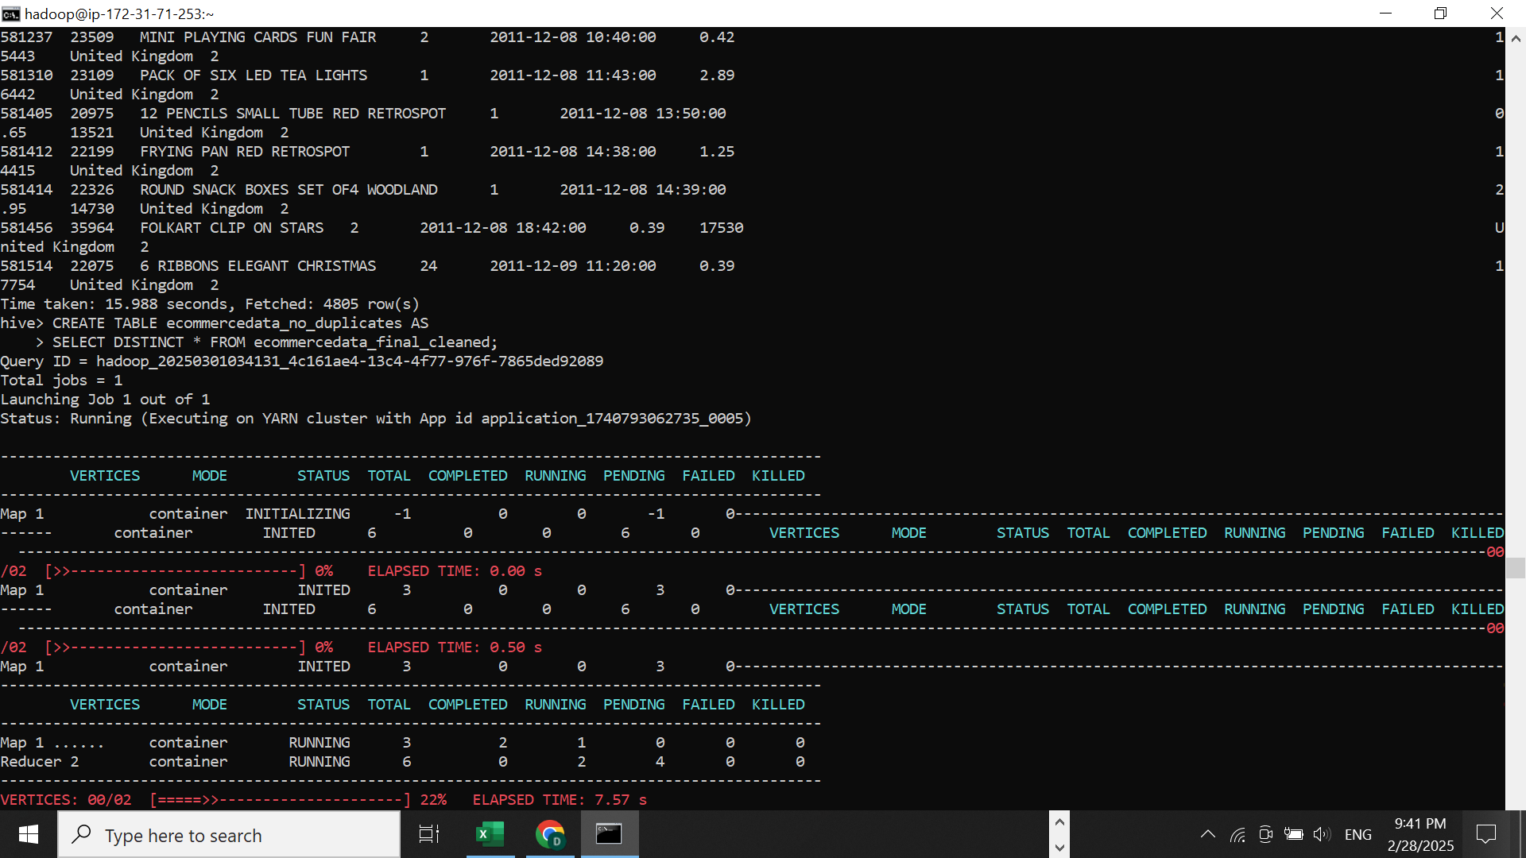
Removing Duplicate Records

Slide 39
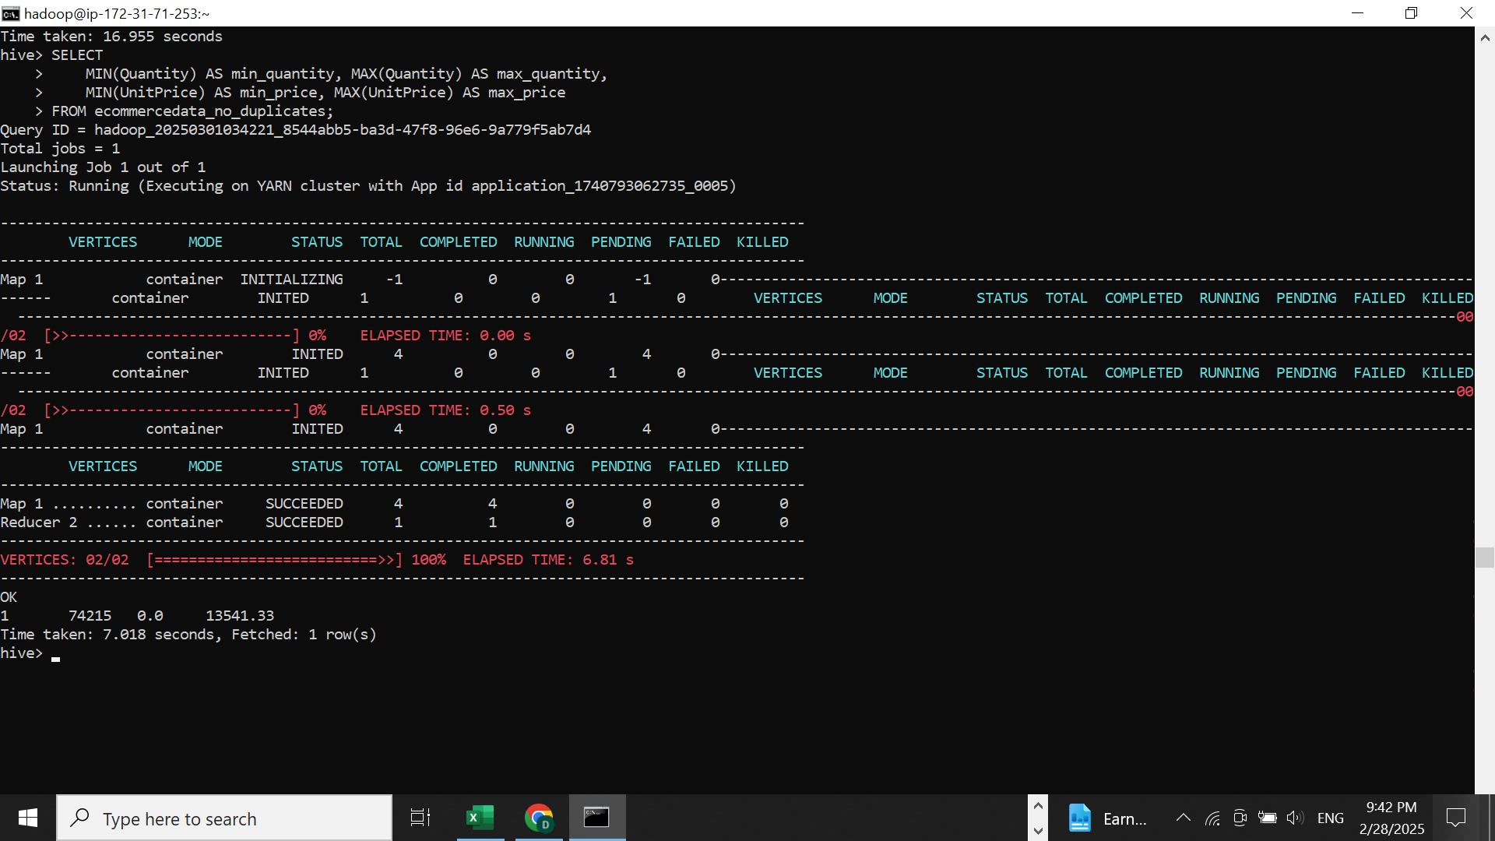
Normalizing Unit Price and Quantity

Slide 40
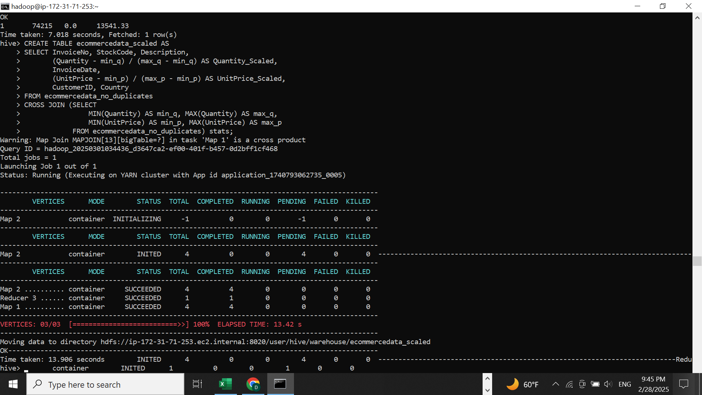
Scaling

Slide 41
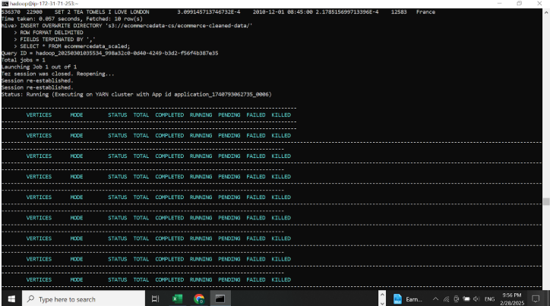
OVERWRITE DIRECTORY is used for storing the cleaned data back into the S3 bucket.

Slide 42
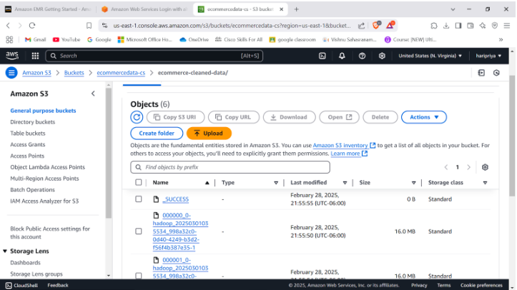
Preprocessed data stored back to S3 bucket.

Slide 43
Explanation of Data Preprocessing Results
Removing all Null values: By giving column names with NOT NULL we were able to retrieve the rows that are not null.
Clear all negative values: Negative values were found in 2 columns i.e, in Quantity and UnitPrice , By using WHERE Quantity >= 0 and UnitPrice >= 0.
Removing Duplicate Records: By performing a query using DISTINCT we were able to fetch data without any duplicate values.
Normalizing Unit Price and Quantity: In this step we are trying to find max and min values which will help for Scaling.
Scaling: Scaling for Quantity and Unitprice was done by applying the formula X′= (X - Xmin)/(Xmax - Xmin).
Standardizing InvoiceDate Format: By using UNIXTIME we converted the format of the date and time from MM/DD/YYYY to YYYY/MM/DD.
All the output files were merged and stored back to S3

Slide 44
Data Analysis

Slide 45
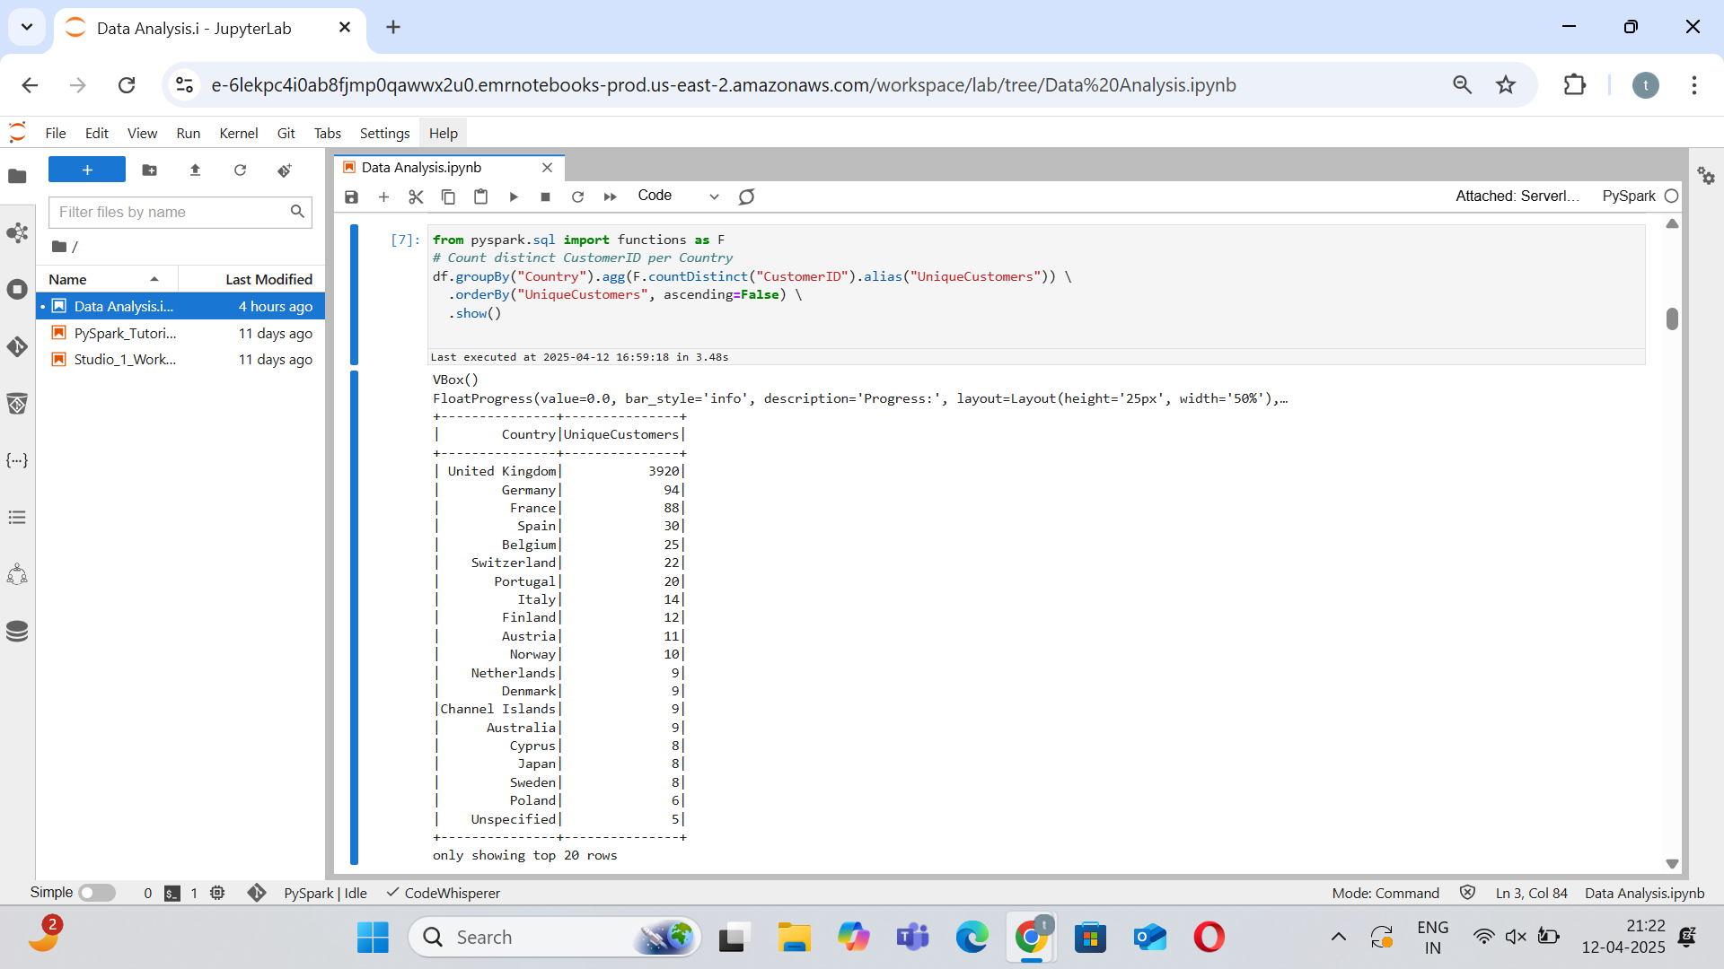
Count of Customers per Country

Slide 46
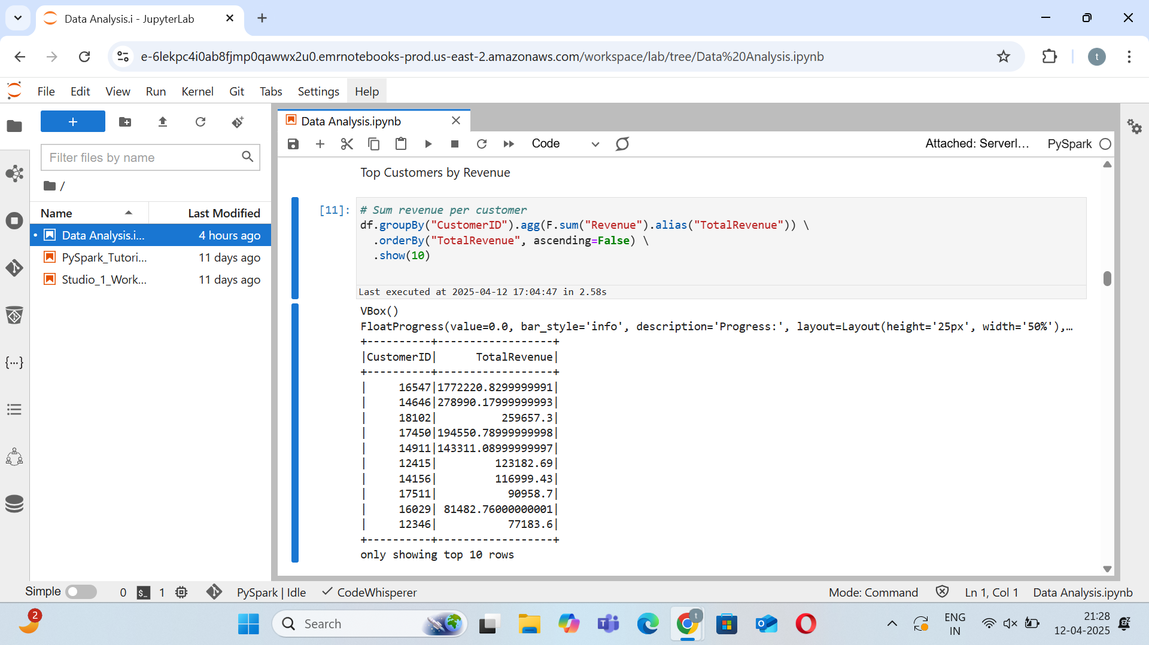
Top Customers by Revenue

Slide 47
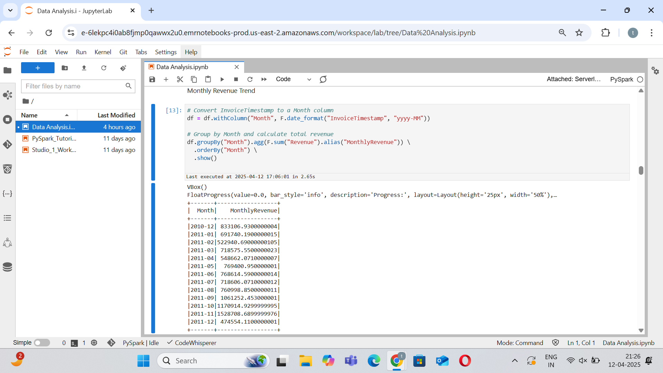
Monthly Revenue Trend

Slide 48
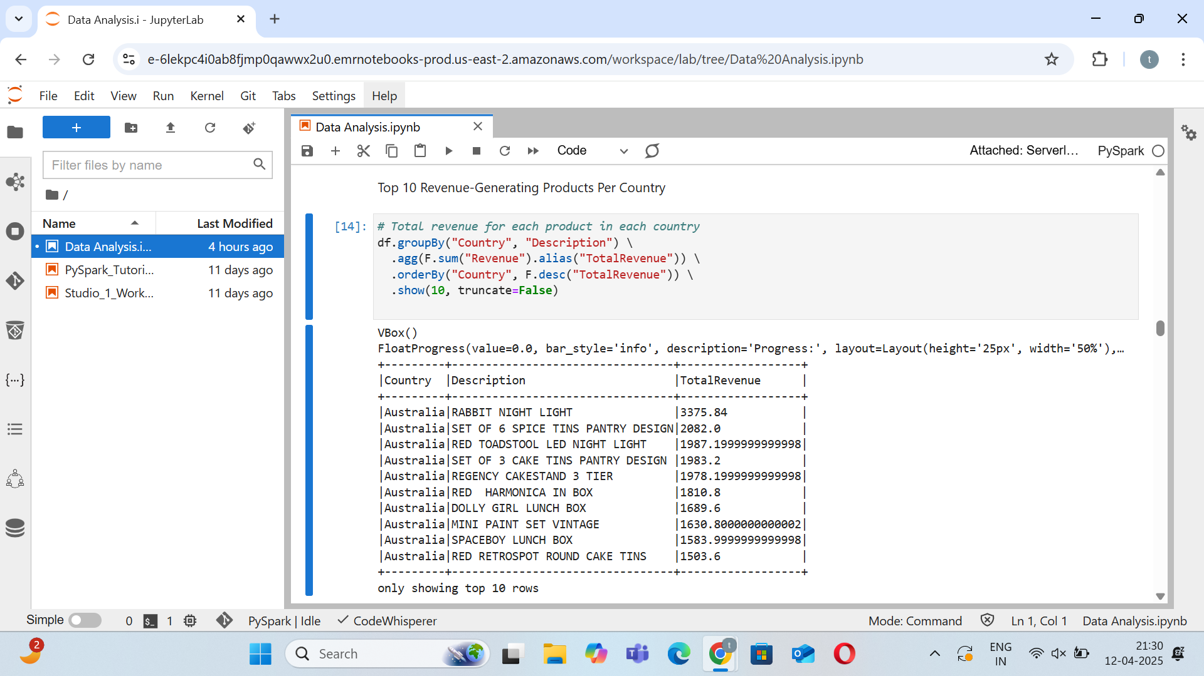
Top 10 Revenue-Generating Products Per Country

Slide 49
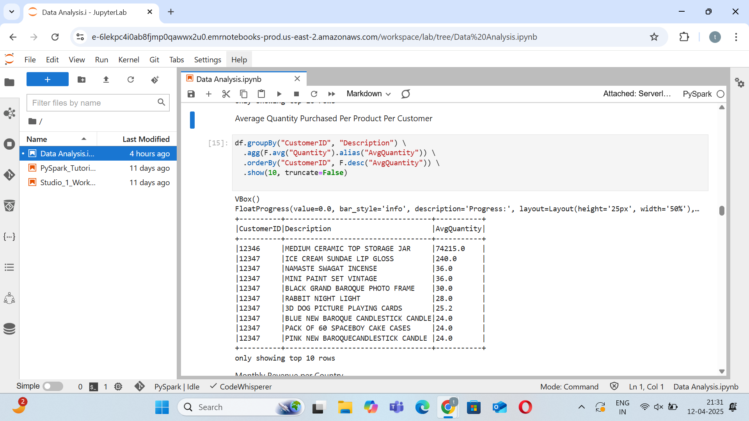
Average Quantity Purchased Per Product Per Customer

Slide 50
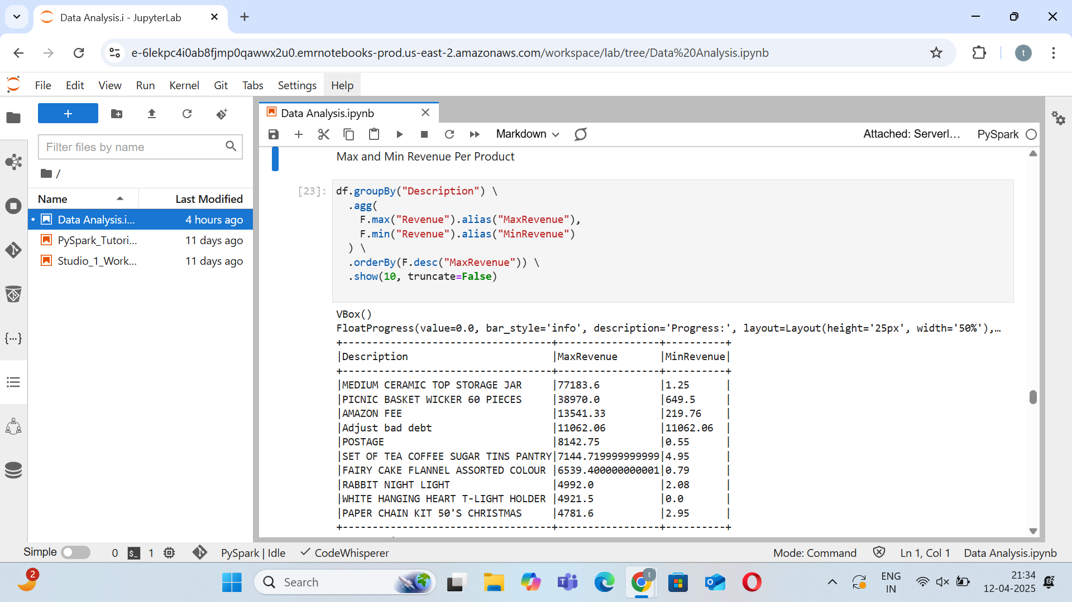
Max and Min Revenue Per Product

Slide 51
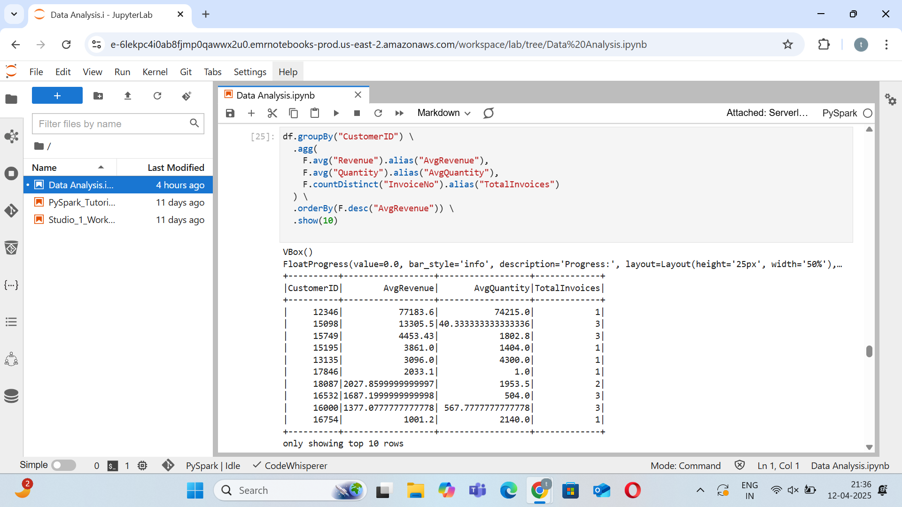
Customer Purchase Behavior: Avg Revenue, Quantity, & Invoices

Slide 52
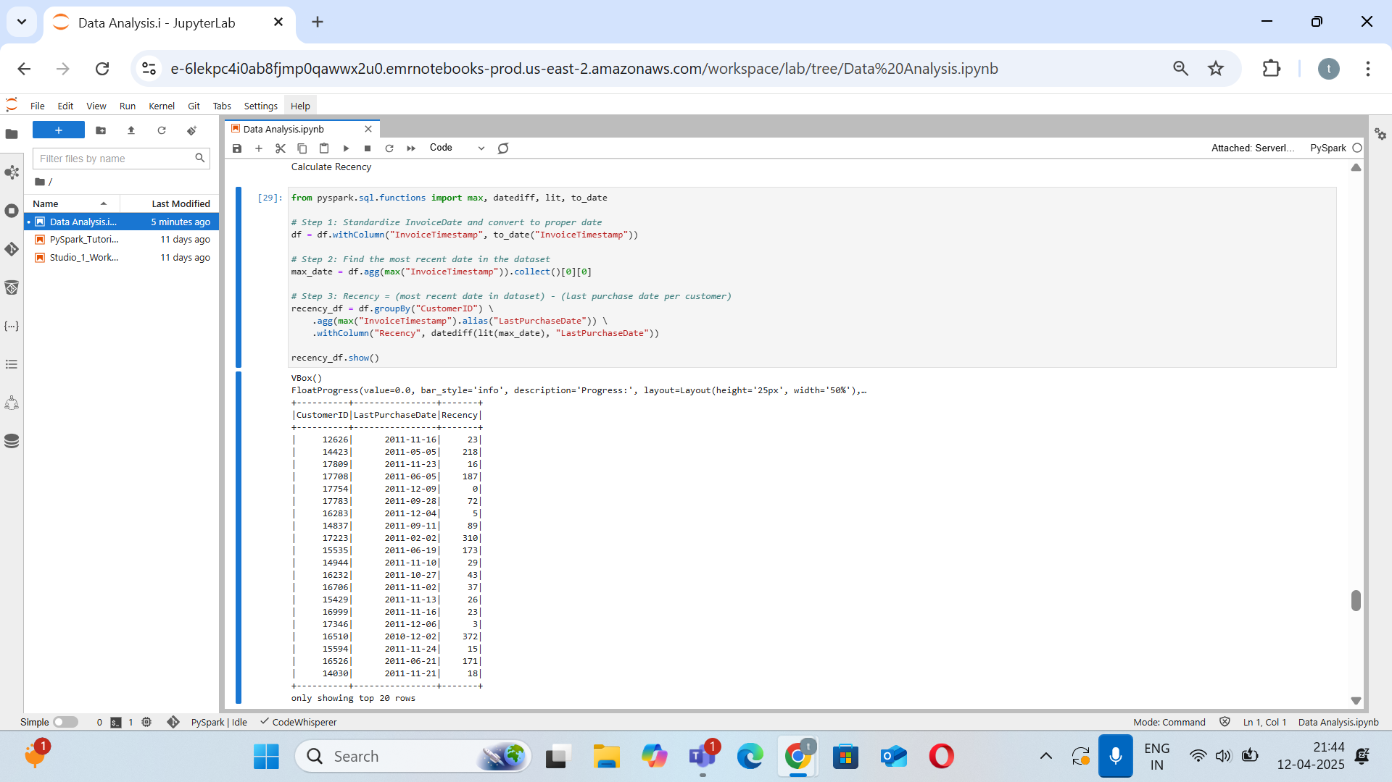
Calculate Recency

Slide 53
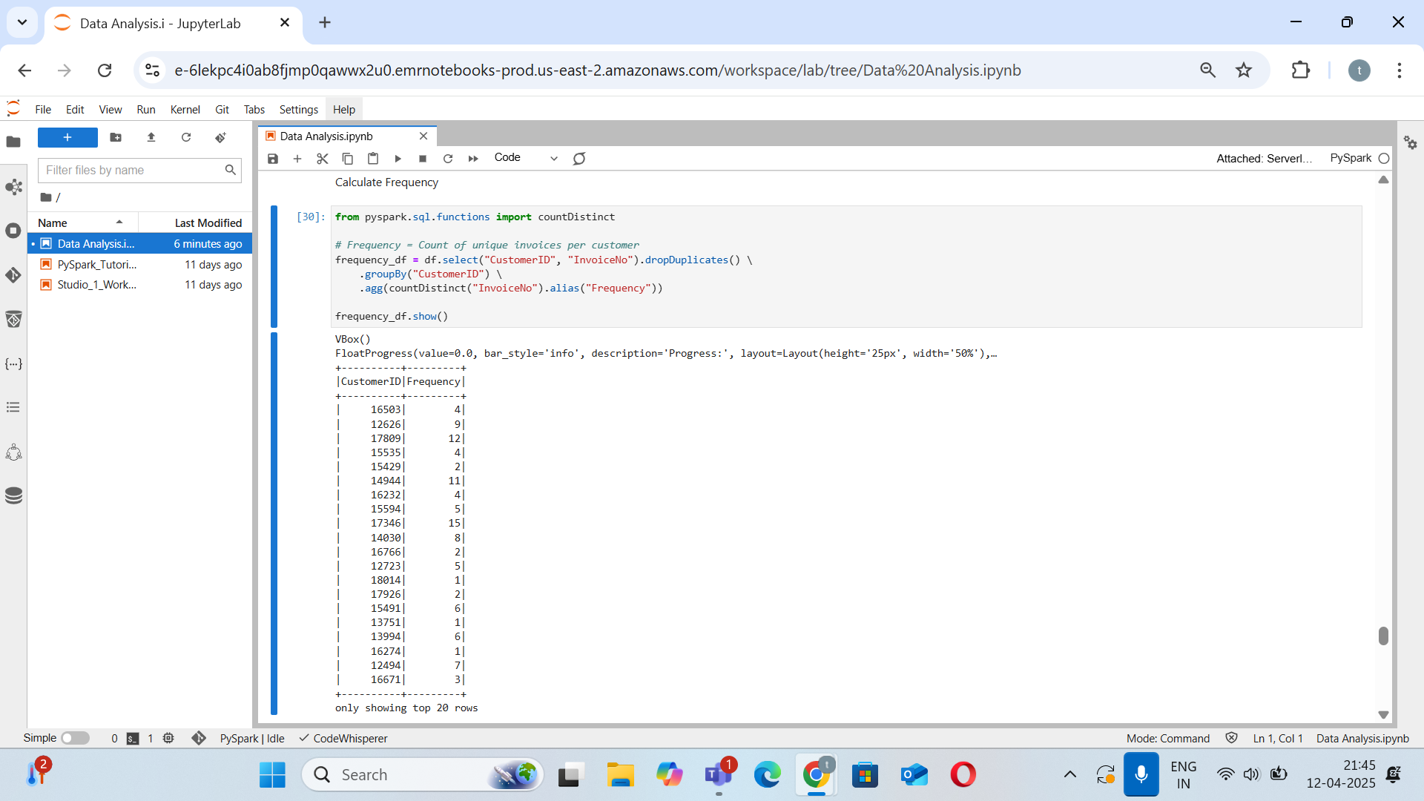
Calculate Frequency

Slide 54
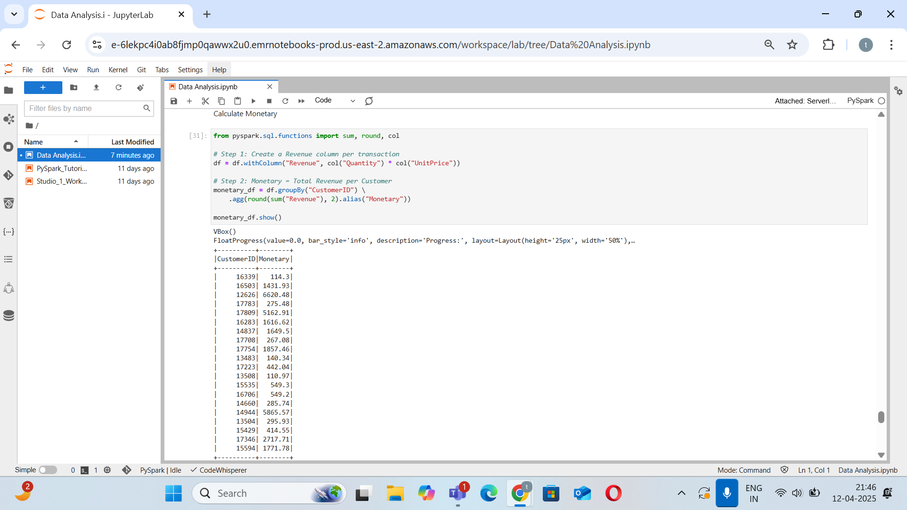
Calculate Monetary

Slide 55
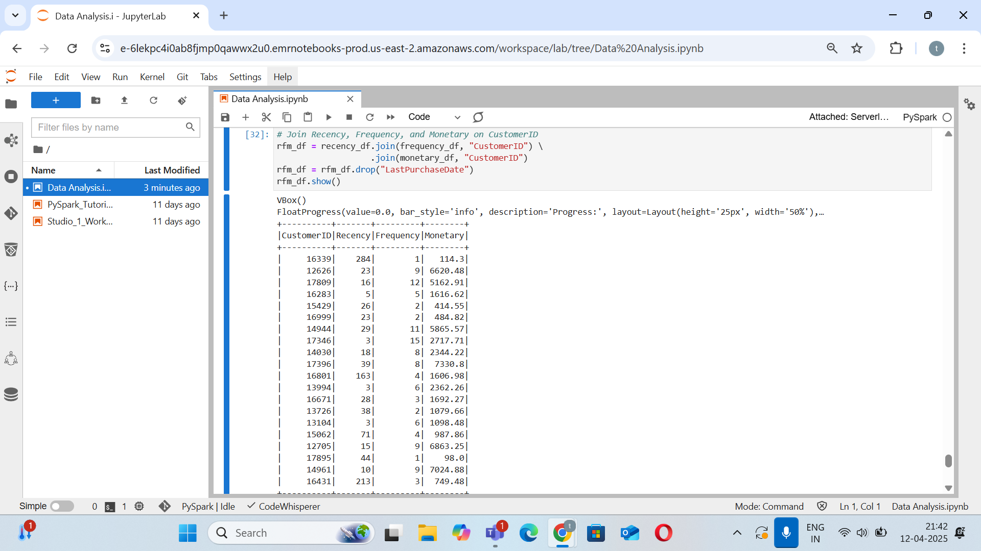
Merging all the metrics into one Dataframe

Slide 56
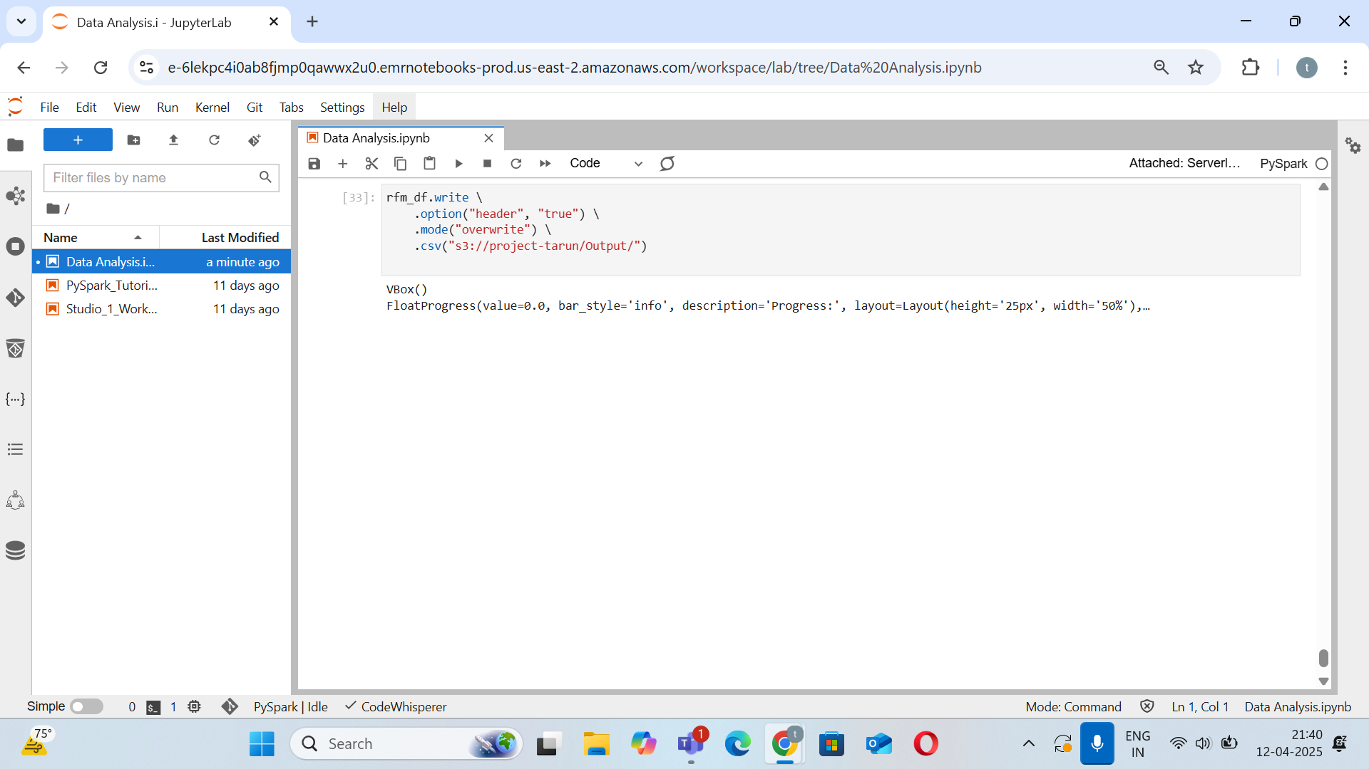
Saving the dataframe as a csv file in S3 bucket

Slide 57
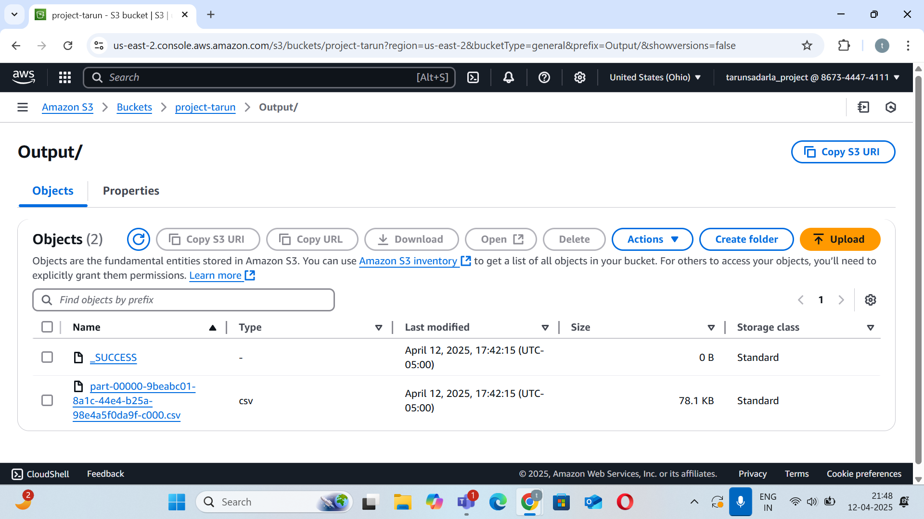
Output folder of S3 bucket

Slide 58
Explanation of Data Analysis Results
Count of Customers per Country: Unique customers by region
Top Customers by Revenue: Highest spending customers
Monthly Revenue Trend: Sales trend over time
Top 10 Revenue-Generating Products Per Country: Bestsellers by country
Average Quantity Purchased Per Product Per Customer: Typical purchase quantity
Max and Min Revenue Per Product: Product revenue extremes
Customer Purchase Behavior: Avg Revenue, Quantity, & Invoices: Overall buying behavior
Calculate Recency, Frequency, Monetary: RFM for segmentation

Slide 59
Machine Learning

Slide 60
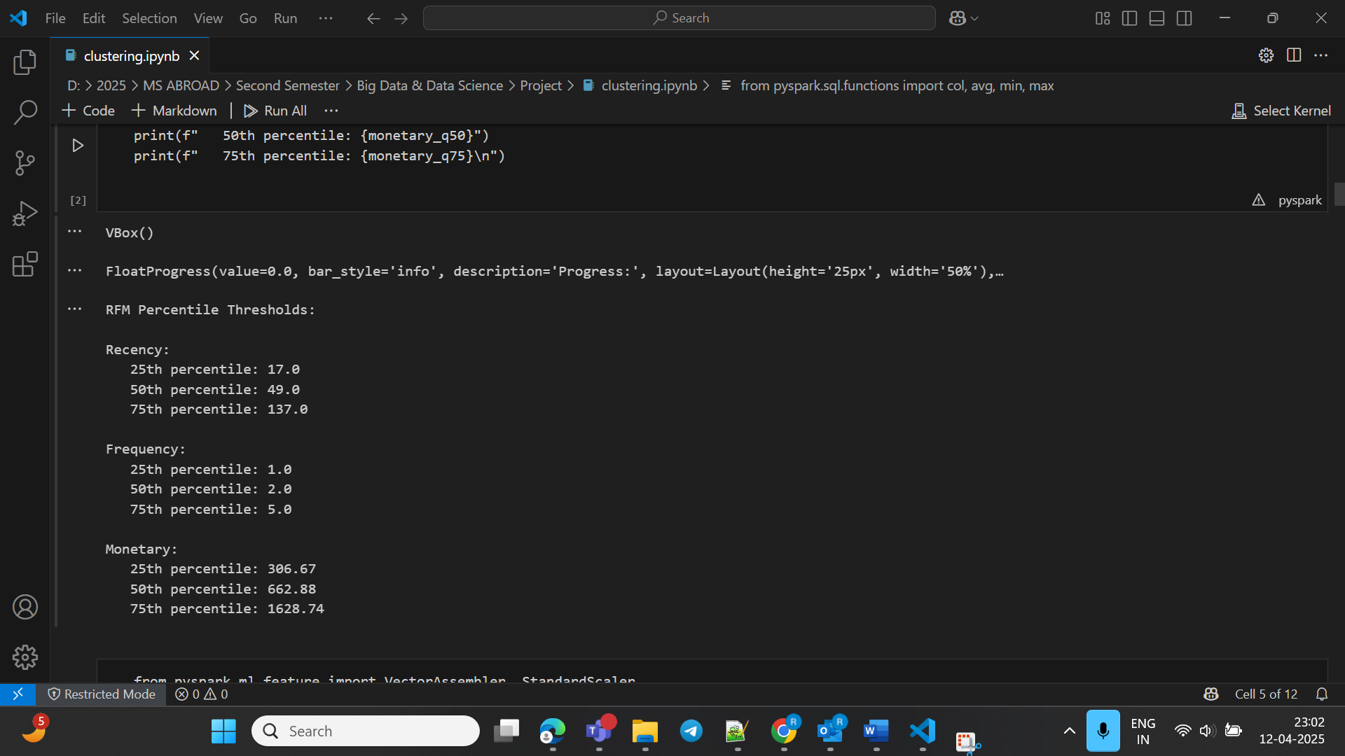
RFM Percentile Thresholds:

Slide 61
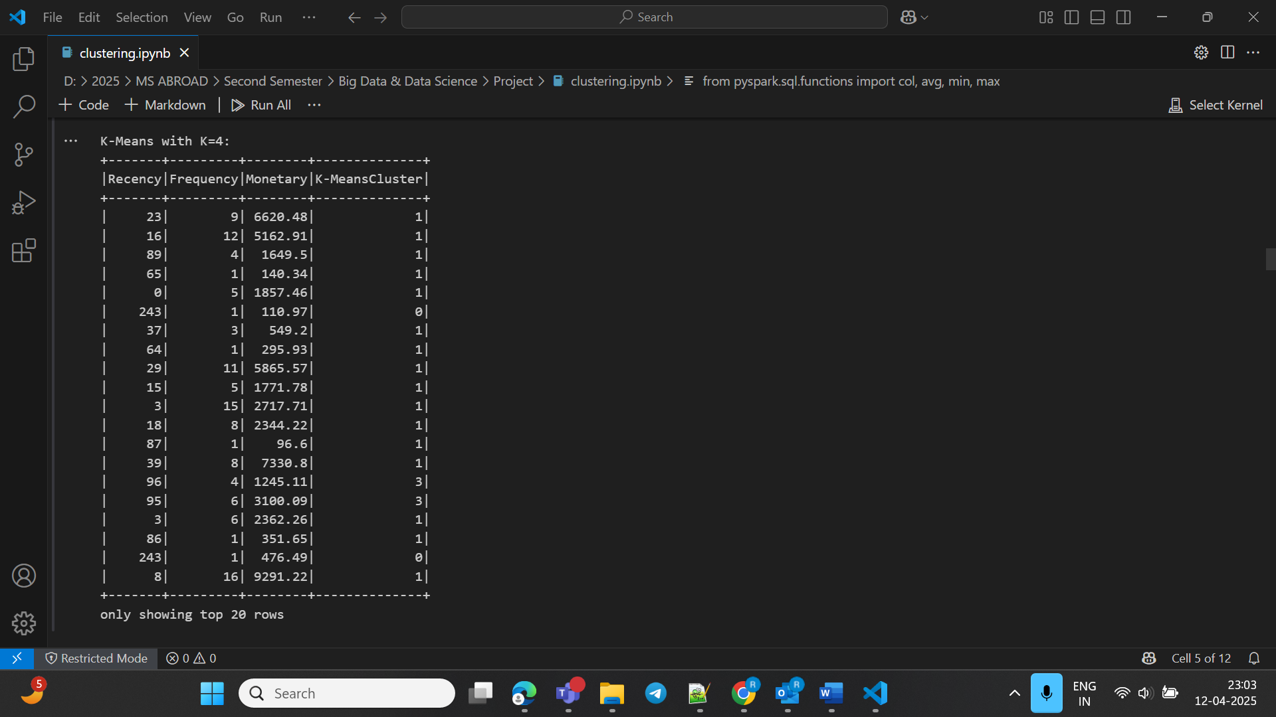
K-Means Clustering:

Slide 62
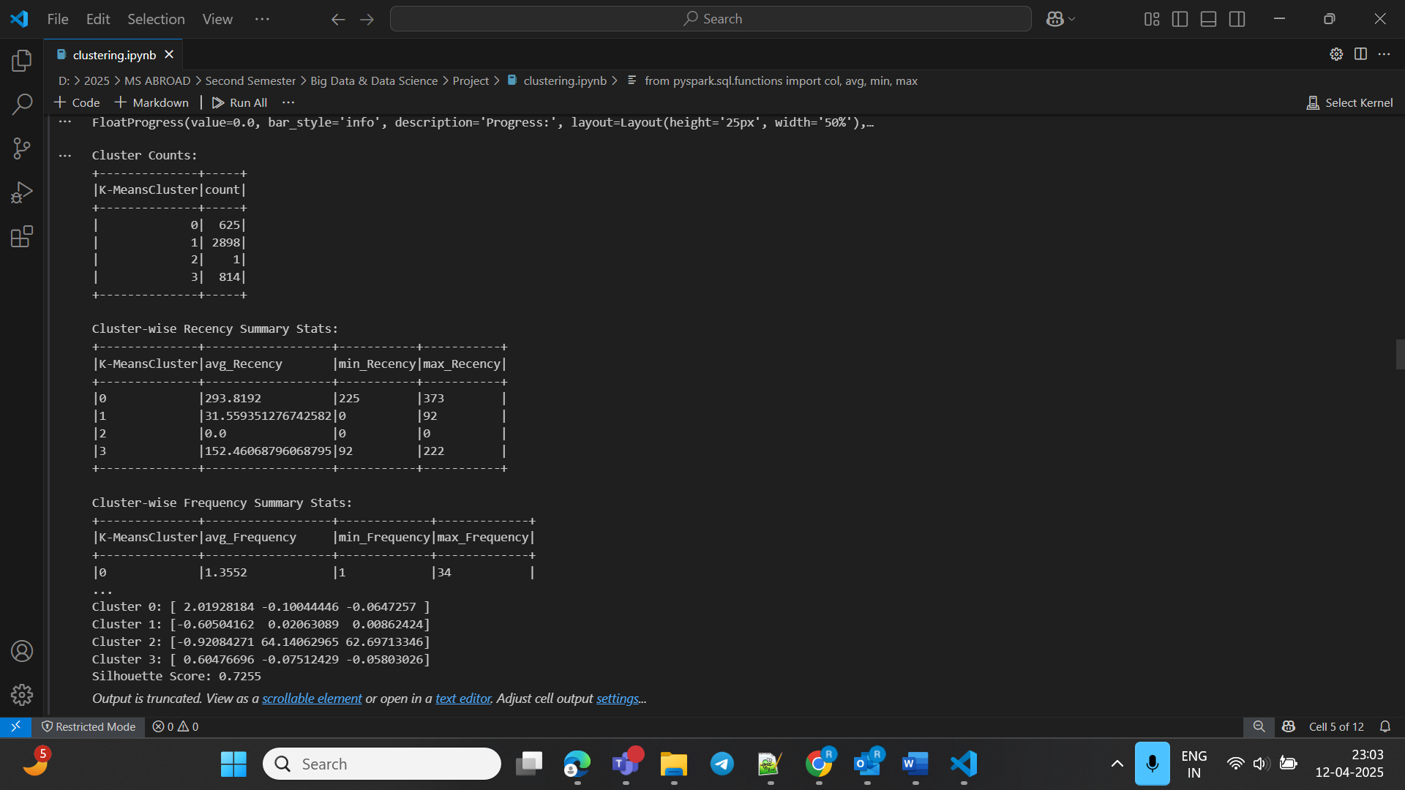
Statistics and Evaluation of K-Means:

Slide 63
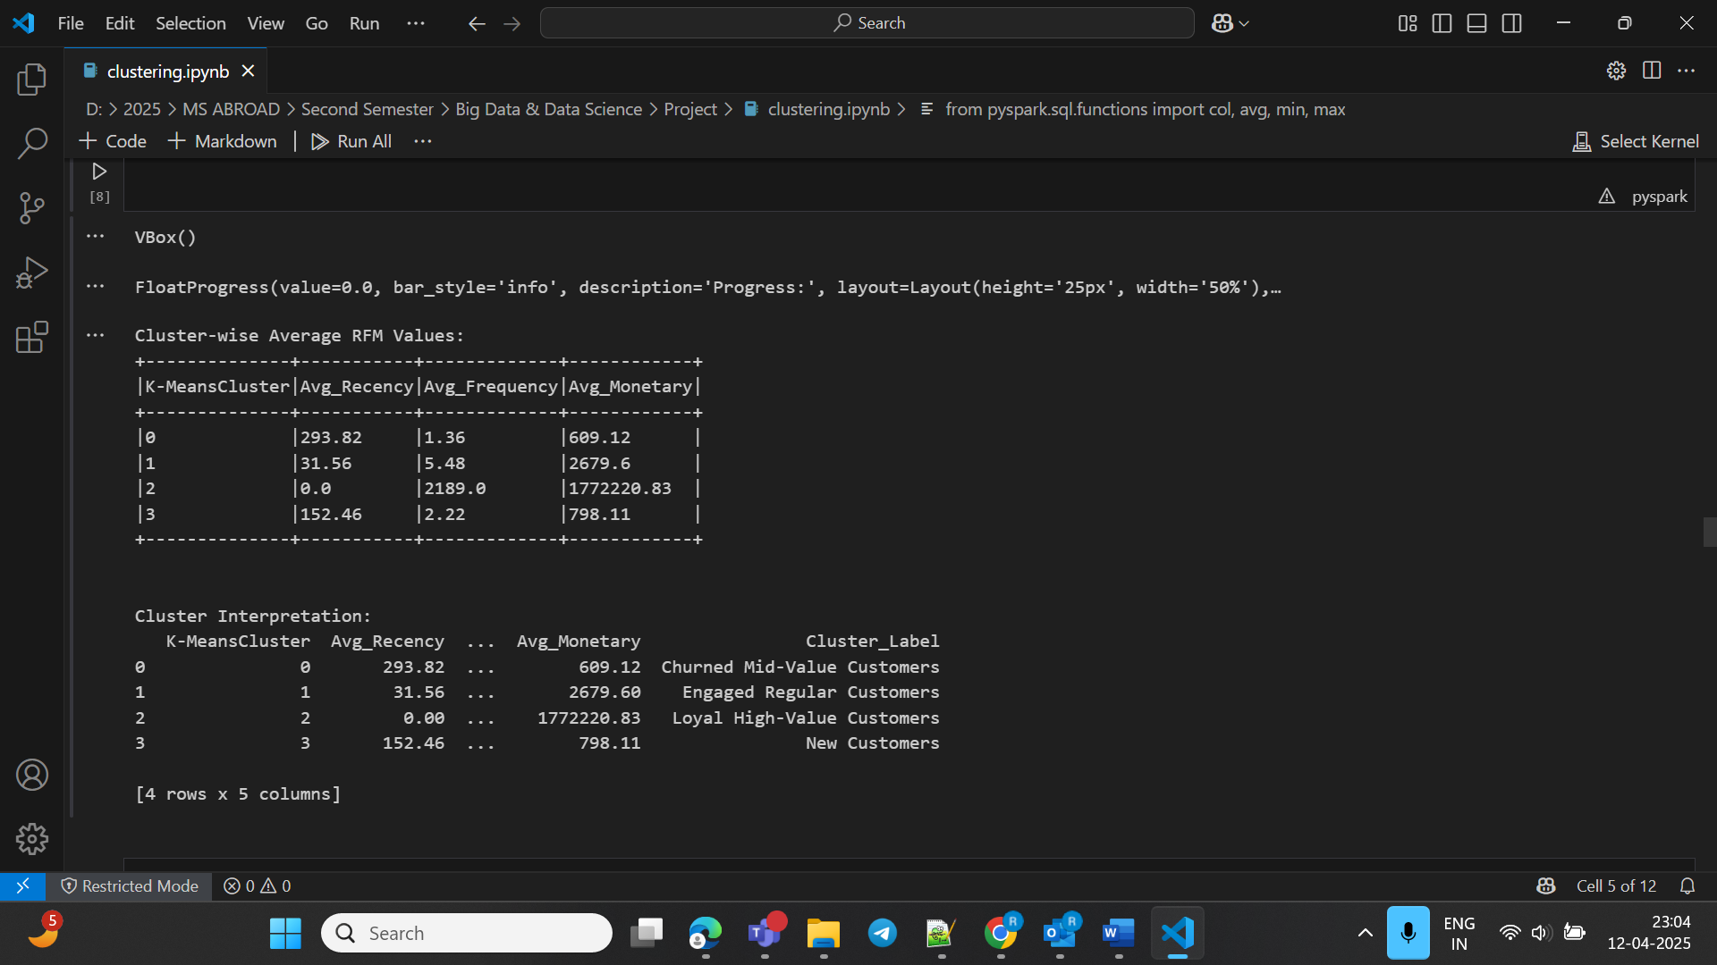
Cluster Interpretation using K-Means:

Slide 64
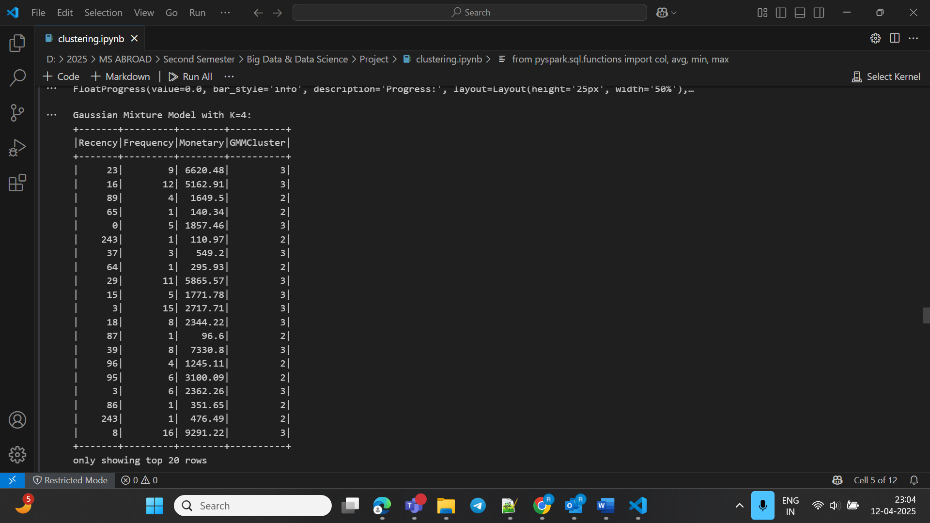
Gaussian Mixture Model Clustering:

Slide 65
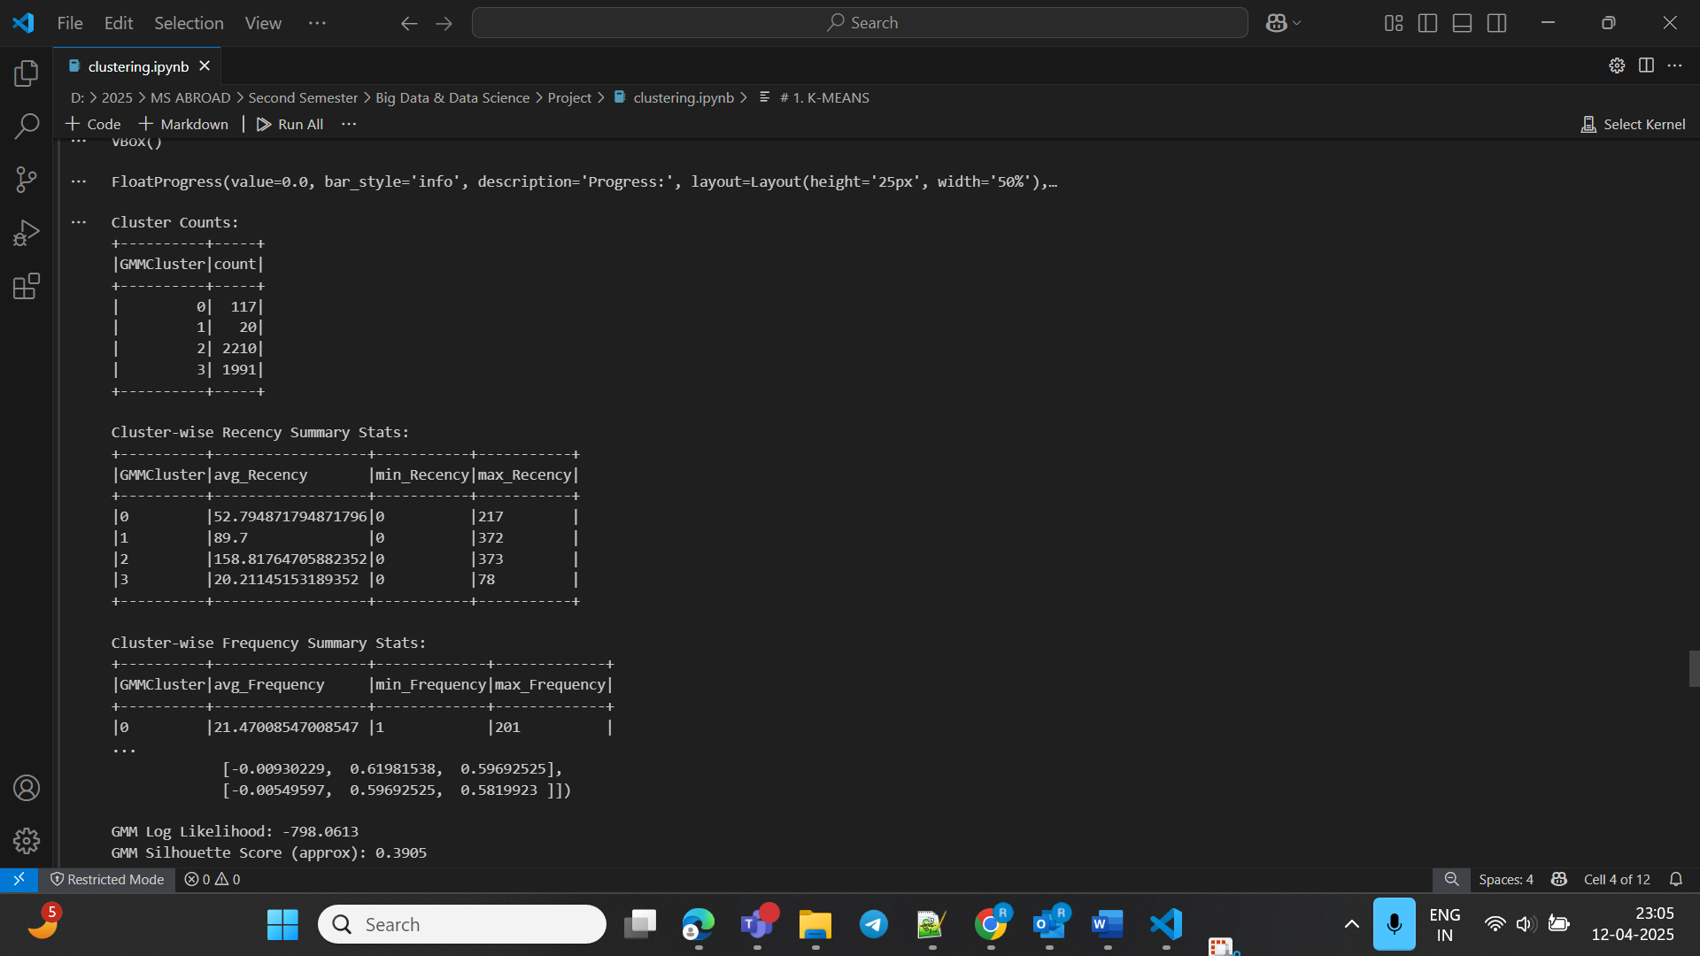
Statistics and Evaluation of GMM:

Slide 66
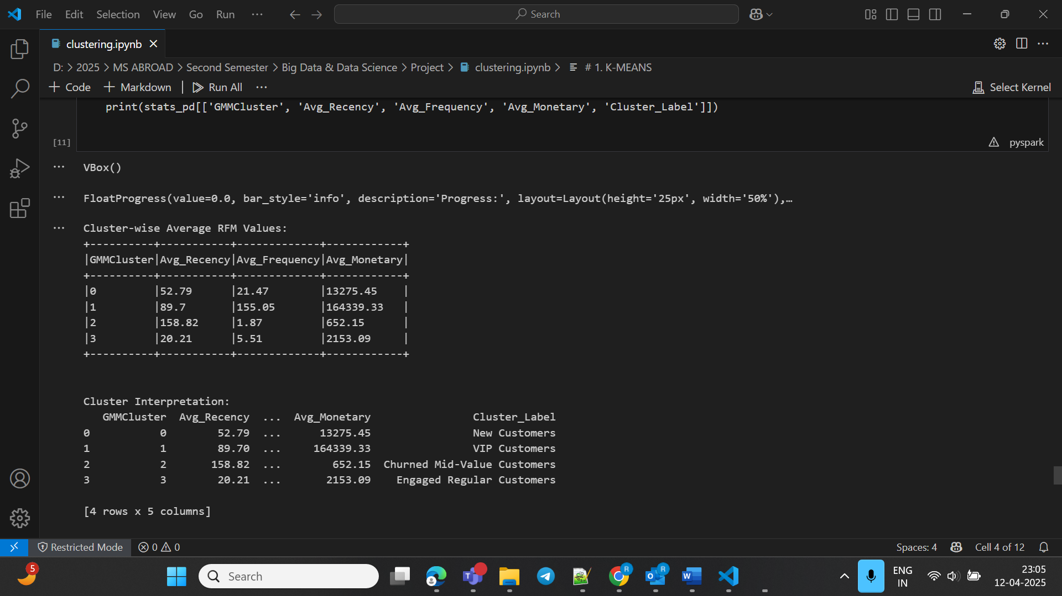
Cluster Interpretation using GMM:

Slide 67
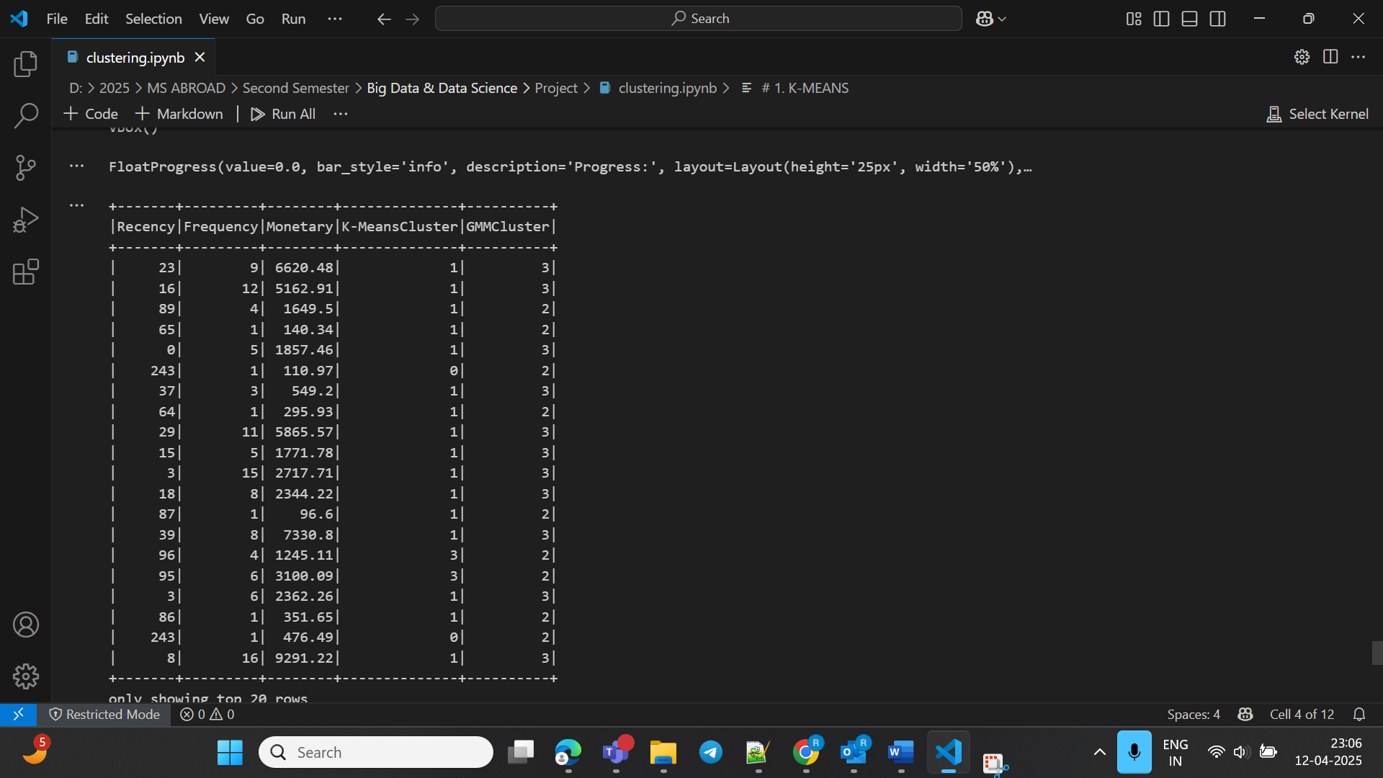
Displaying Cluster Results of K-Means and GMM:

Slide 68
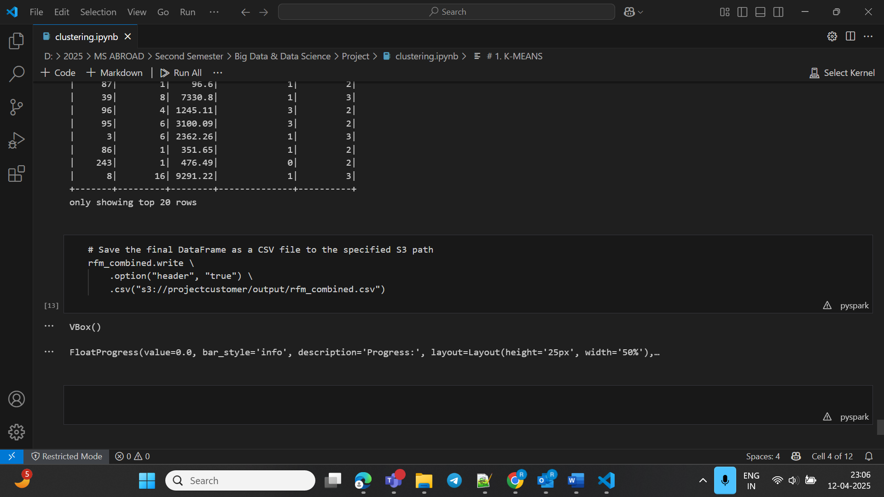
Storing Final Result into S3 Bucket:

Slide 69
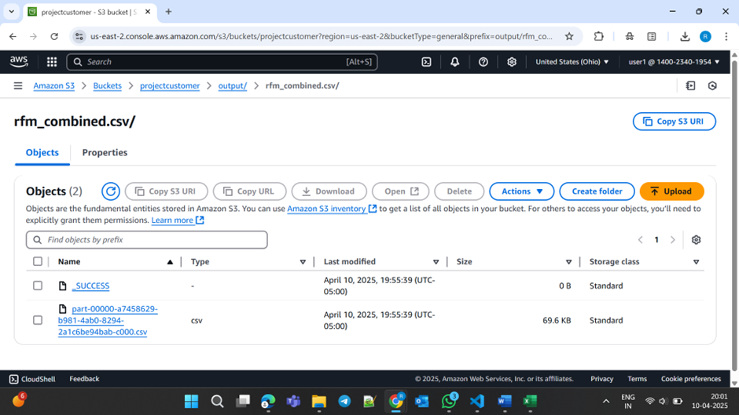
Final Data in S3:

Slide 70
Explanation of Clustering results using ML Models
RFM Percentile Thresholds: Computed percentile values for Recency, Frequency and Monetary features for cluster interpretation.
K-Means Clustering: Segmenting customers using K-Means algorithm on RFM data.
Statistics and Evaluation of K-Means: Evaluated K-Means clustering using metrics like Silhouette score and analyzed summary statistics for each cluster.
Cluster Interpretation using K-Means: Labelled each cluster based on percentile distribution.
Gaussian Mixture Model Clustering: Segmenting customers using GMM algorithm.
Statistics and Evaluation of GMM: Evaluated GMM clustering using metrics like approximate Silhouette score and analyzed summary statistics for each cluster.
Cluster Interpretation using GMM: Labelled each cluster based on percentile distribution.
Displaying Cluster Results of K-Means and GMM: Displaying the cluster results of both K-Means and GMM for comparison.
Storing Final Result into S3 Bucket: Saved the final cluster results to S3 bucket for visualization and shared the report for further analysis.

Slide 71
Uniqueness of our project:
Dual Clustering model comparison in Pyspark to explore hard vs soft clustering in customer segmentation using K-Means and Gaussian Mixture Models (GMM).
Interpretability through Percentile-Based naming using statistical measures like percentiles, min, max, and averages unlike generic cluster labelling.
Overcoming limitations of Spark MLlib such as lack of inbuilt AIC/BIC metric for GMM.
Integrated evaluation across these 2 models despite different evaluation metrics using approximate silhouette score.
Scalable implementation with S3 integration which is suitable for real-time production use in big data environments.

Slide 72
Data Visualization

Slide 73
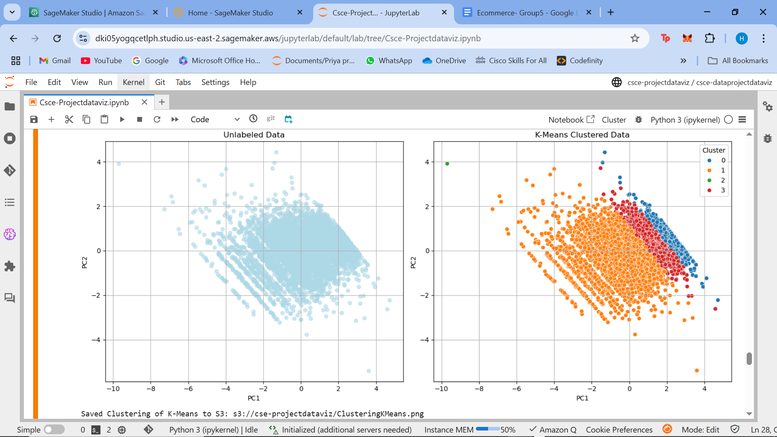
Cluster Visualization of K-Means

Slide 74
Cluster Visualization of K-Means
K-Means Clustering Visualization was performed with help of PCA(Principal Component Analysis) for better understanding
With the help of PCA the high dimensional data was reduced for visualizations, it also preserves variance so that important patterns will be retained. In simple words complex dataset can be visualized in a easy way.
The left plot is the unlabeled data and the right plot is after K-Means Clustering
Helps in understanding that clustering has grouped similar customers.

Slide 75
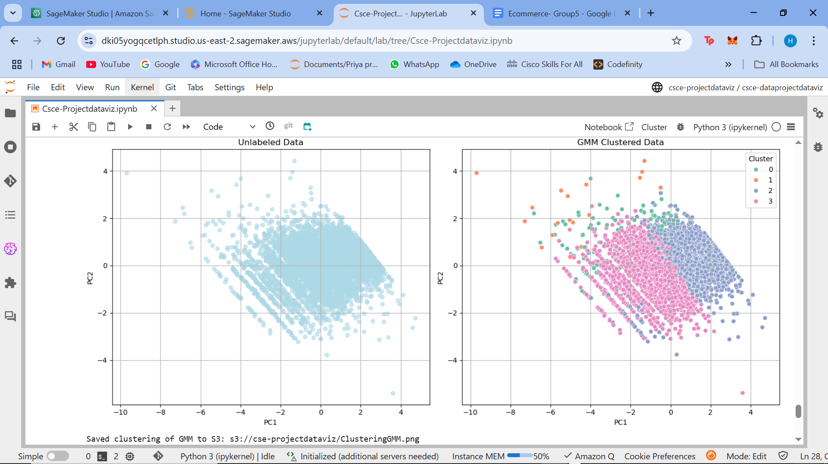
Cluster Visualization of GMM (Gaussian Mixture Model)

Slide 76
Cluster Visualization of GMM
GMM Clustering Visualization was also performed with help of PCA(Principal Component Analysis) for better understanding
With the help of PCA the high dimensional data was reduced for visualizations, it also preserves variance so that important patterns will be retained. In simple words complex dataset can be visualized in a easy way.
The left plot is the unlabeled data and the right plot is after GMM Clustering
Each color represents different cluster, grouping similar data.

Slide 77
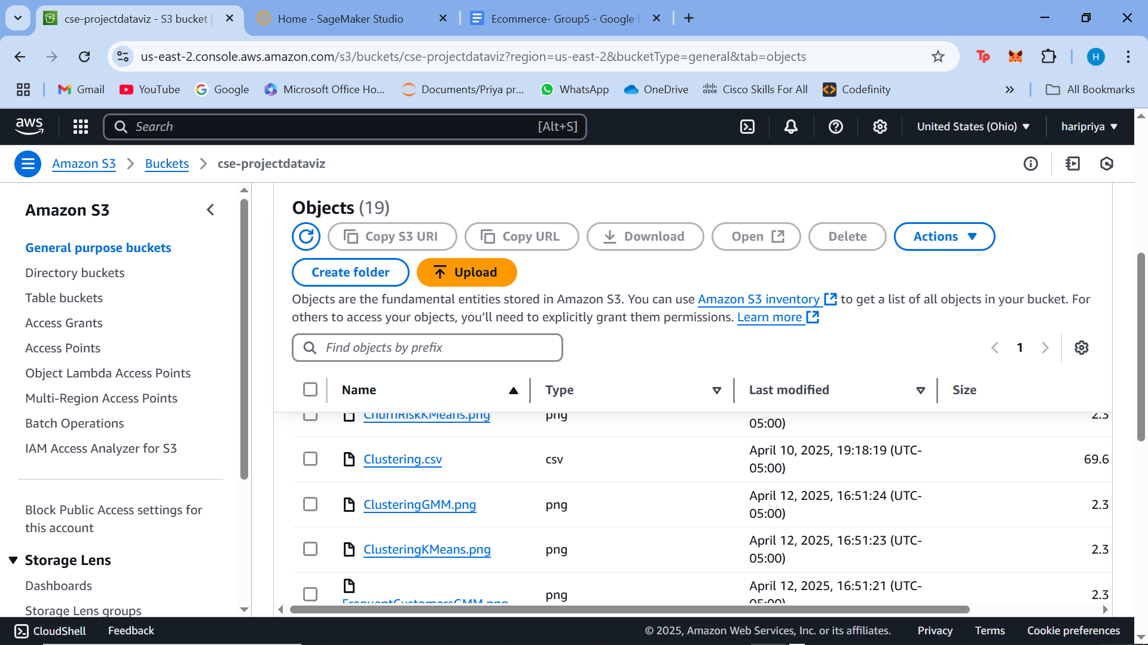
Visualizations stored back to S3 as png

Slide 78
References &
Bibliography

Slide 79
AWS Documentation – Amazon Web Services. (n.d.). Amazon S3 and EMR User Guide. Retrieved from https://docs.aws.amazon.com
GeeksforGeeks – (n.d.). Data Cleaning and Preprocessing Techniques in Python. Retrieved from https://www.geeksforgeeks.org
YouTube Tutorials – Various content creators. (n.d.). Step-by-Step Guides on AWS EMR, HiveQL, and Data Processing.
HiveQL Documentation – Apache Software Foundation. (n.d.). Hive Query Language Reference. Retrieved from https://cwiki.apache.org/confluence/display/Hive/LanguageManual
Course Materials & Lecture Notes – University Course CSCE 5300 Big Data and Data Science

Slide 80
MLlib Clustering documentation: https://spark.apache.org/docs/latest/mllib-clustering.html
Spark Documentation: https://spark.apache.org/docs/latest/sql-programming-guide.html
Used ChatGPT, Google Search engine, few github codes and repositories at various stages throughout the project.

